Slide 1

ECU IMPACT
Chandra Speight, PhD, RN, ECU College of Nursing
Courtney Caiola, PhD, ECU College of Nursing
David H. Ryan, MD, ECU Brody School of Medicine
Acknowledgements:
ECU Health Foundation, PSUDS Network, ECU IMPACT Working Group Members

Slide 2
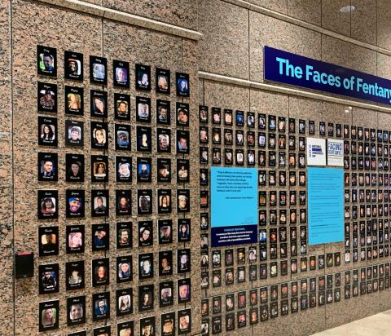
41% of US adults report personally knowing at least one person who died by overdose
(Athey et al., 2024)
Notes:
A lot of us bring a lot of emotion to conversations about this disease process. We have to be patient with each other as we work through them.

Slide 3
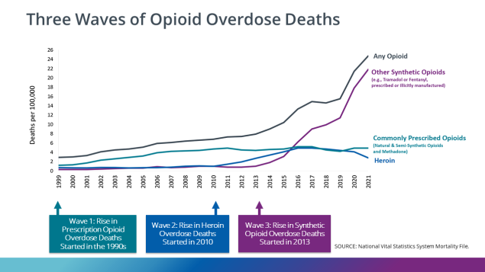
History of Substance Use Crisis
Source: CDC, 2025c

Slide 4
In the US alone, there were 240 million opioid prescriptions dispensed in 2015, nearly one for every adult in the general population.
(Makary et al., 2017)
Notes:
Makary, M. A., Overton, H. N., & Wang, P. (2017). Overprescribing is major contributor to opioid crisis. BMJ (Online), 359, j4792-j4792. https://doi.org/10.1136/bmj.j4792
In some of our counties in the east, there were more than 100 prescriptions written per 100 people!

Slide 5
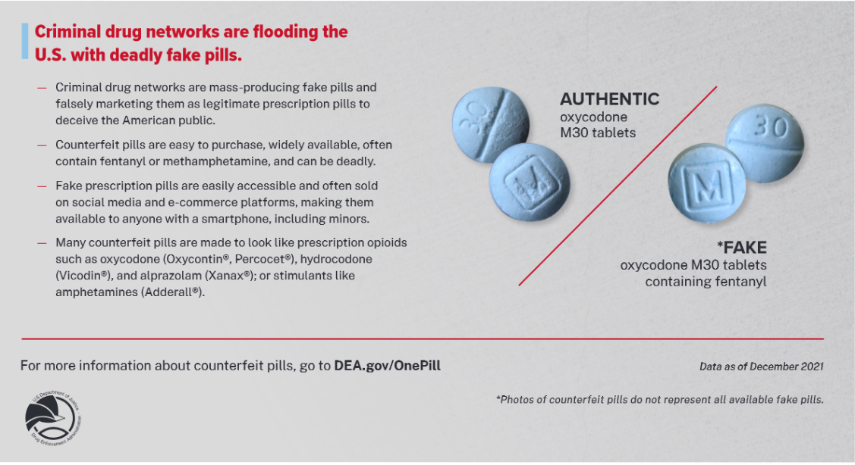
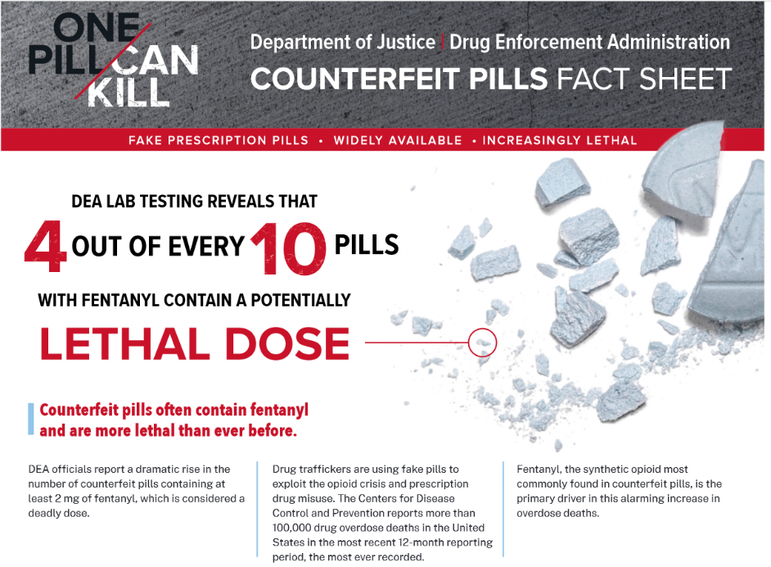
The Overdose Crisis
Source: DEA, n.d.
Notes:
We have two related but not mutually exclusive crises going on – we have an overdose crisis going on and then we have an SUD crisis –it’s important to remember that while related they are not necessarily the same. Many folks who have died of overdose would not meet SUD or OUD criteria – this is linked to the contamination of our drug supply with fentanyl
CS Slide

Slide 6
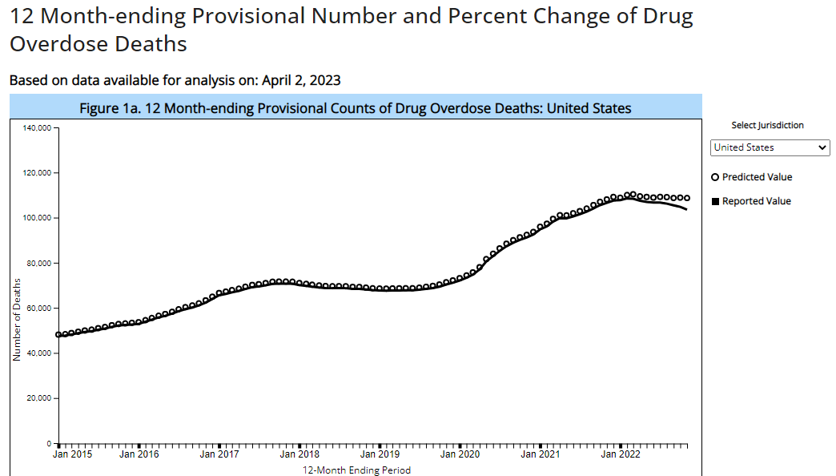
Overdose Epidemic 2015-2021
2021
107,622
45,799 suicides (2020)
42,915 traffic deaths
24,576 homicides
100,000
113,290
32%
21%
11%
4%
4%
Source: CDC, 2025b

Slide 7
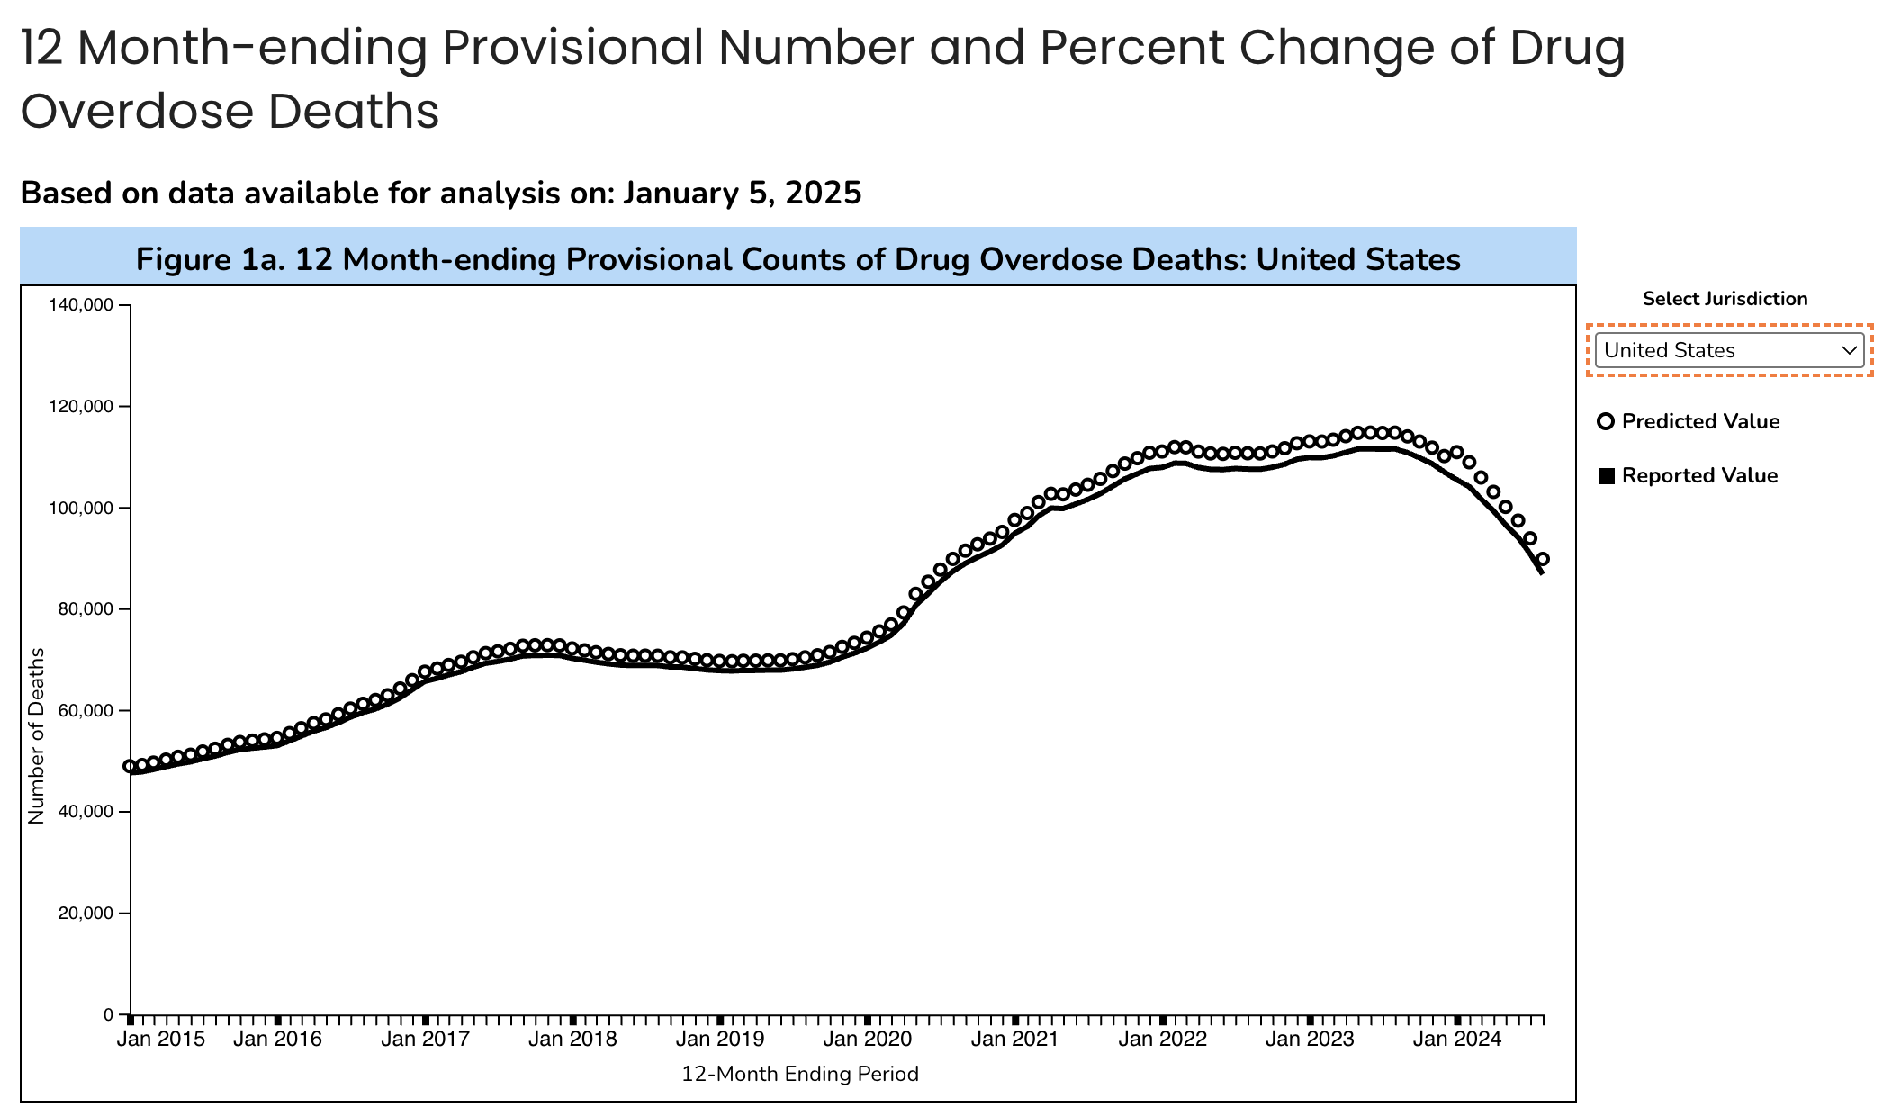
~87,000
22% DECREASE
Source: CDC, 2025b

Slide 8
Theories Behind Decline
Removing treatment barriers
Naloxone distribution
Fentanyl seizures/arrests
Xylazine presence
Alternate routes -- Shift to smoking
Fewer susceptible people alive
Education – Anti-Stigma/Public Awareness
Source: Miller, 2025

Slide 9
BUT. . . .

Slide 10
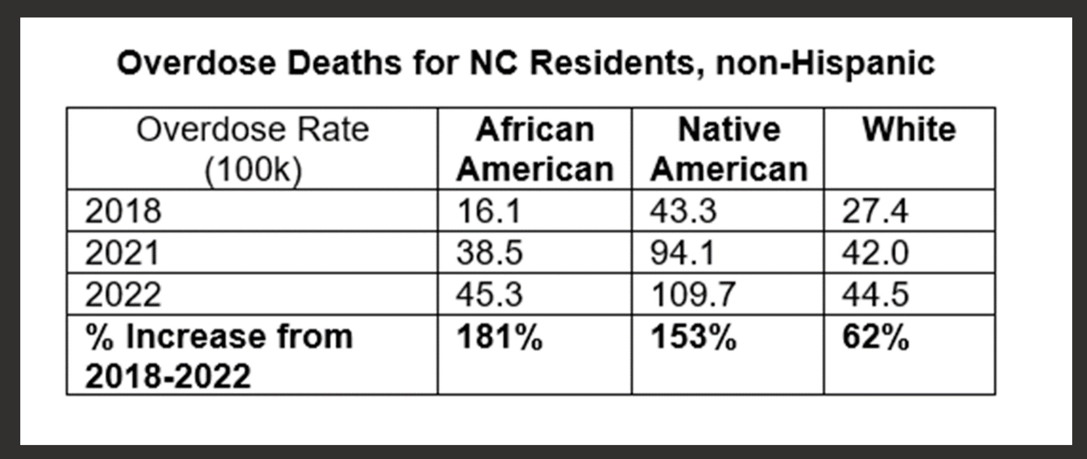
SUD in Eastern North Carolina
Location | Overdose Death Rate (100k) 2021 | Overdose Death Rate (100k) 2022 | Overdose Death Rate (100k) 2023 | Overdose Death Rate (100k) 2024 Projected
US | 32.4 | 33.0 | 31.3 | --
NC | 38.5 | 40.6 | 41 | --
ENC-29 | 39.1 | 41.2 | 42.8 | --
Select ENC Counties
Beaufort | 40.5 | 54.1 | 51.7 | 30.8
Carteret | 49.5 | 56.3 | 41.7 | 24.4
Craven | 62.7 | 89 | 79.1 | 24.7
Greene | 24.7 | 24.5 | 24.4 | 33.2
Jones | 32.6 | 65.1 | 42.5 | 0
Lenoir | 36.6 | 40.4 | 41.9 | 18.6
Pamlico | 81.0 | 106.3 | 64.4 | 41.0
Source: NCDHHS Opioid Dashboard, retrieved Sept 26, 2025
Notes:
In 2022, approximately 11 North Carolinians die each day of unintentional drug overdose
Most involved opioids
Despite similar rates of substance use, we see racial & rural disparities in death rates.

Slide 11

Rural Disparities: Why?
41 of NC’s 100 counties in highest risk group for opioid-related harm based on high overdose death rates and low treatment capacity (Hafajee et al., 2019)
National study identifying areas most needing SUD treatment access designated rural eastern NC counties a priority (Kane and Topmiller, 2022)
7 (58%) of the 12 NC counties without a buprenorphine prescriber are in eastern NC, all rural (SAMHSA, 2024)
61% of eastern NC counties have NO opioid treatment program (SAMHSA, 2024)
Transportation challenges for rural residents (Hedegaard, 2021)
Lack of access to counseling services (Hedegaard, 2021)
Until May 2025, NO perinatal addiction services

Slide 12
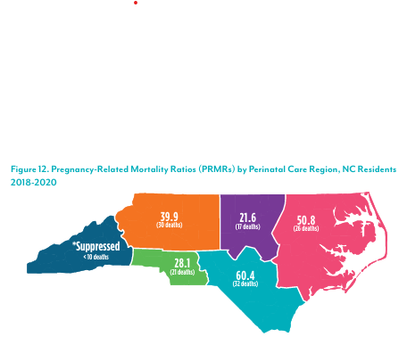
NC MMRC Report (2018-2020)
Eastern NC Pregnancy-Related Mortality Ratio 2nd highest in state
Timing of pregnancy-related deaths:
17% during pregnancy
35% postpartum, day 1- 42
48% postpartum, day 43 - 1 year
The LEADING cause of pregnancy-related death in NC between 2018-2020 was Mental Health Conditions (43 out of 133)

Slide 13
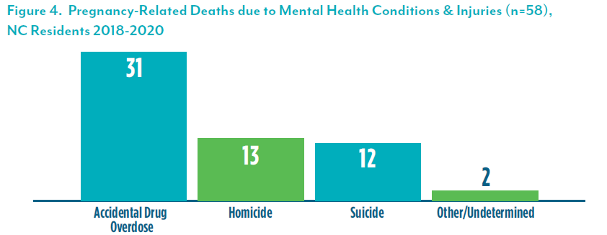
NC MMRC Report (2018-2020)

Slide 14
SUD and Perinatal Population
Substance use disorder (SUD) is a leading cause of maternal mortality
Contributes to adverse patient, family, and community outcomes including preterm labor, stillbirth, low birth weight, maternal overdose, and family dissolution
Over 50% of deaths – review found no substance use screening in perinatal period
Pregnancy and parenthood can be strong motivators for recovery
Sources: Azuine et al., 2019; Bruzelius & Martins, 2022; Quick-Graham et al., 2023
Notes:
>50% NC children in foster care due to parental substance use (cite)

Slide 15

Eastern North Carolina
Until May 2025, NO perinatal addiction services

Slide 16

Integrated Substance Use and Obstetric Care

Slide 17

David H. Ryan
OB/GYN
Board certified OB/GYN
UNC Chapel Hill 2007-2011
Private Practice Greenville 2011-2020
Addiction Medicine Physician
Board certified Addiction Medicine
UNC Chapel Hill Fellowship 2020-2021
VCU Division of Addictions 2021-2022
Walter B Jones Center 2022-2023
ECU Dept of Psychiatry & OB/GYN 2023-present
Division Chief of Addiction Medicine
https://www.youtube.com/watch?v=Fyjf32HrzUM

Slide 18

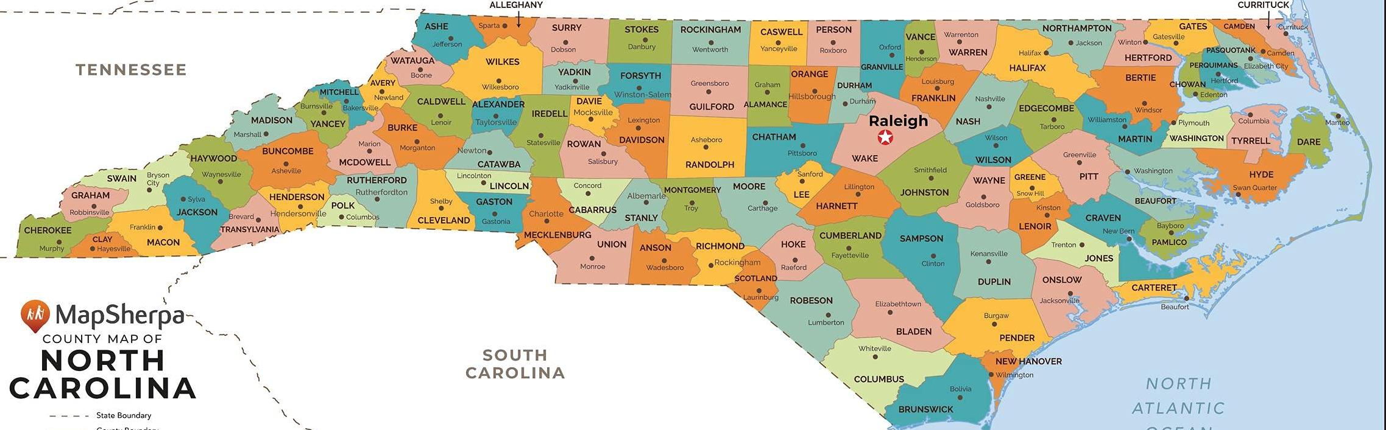
Supportive Network

Slide 19

Substance Use Disorders in Women
Initiation of substance use by women is more often related to:¹
Family or partner use
Mood disorders such as depression or anxiety
Treating negative emotional states
Eating disorders
More likely to have a history of trauma²
Telescoping: May develop substance use disorders and physiologic complications in a shorter time and with less consumption³
Or is it due to difficulty accessing treatment?
Pregnancy and parenthood can be strong motivators for recovery
BUT fear of stigma/consequences can be a deterrent⁴
1 Bahji et al., 2019; Khan, Okuda, et al., 2013; Khan, Secades-Villa, et al., 2013
2 Abraham et al., 2020
3 Brasiliano et al., 2020; Peters, Guille, & Mittal, 2019
4 NIDA, 2020

Slide 20
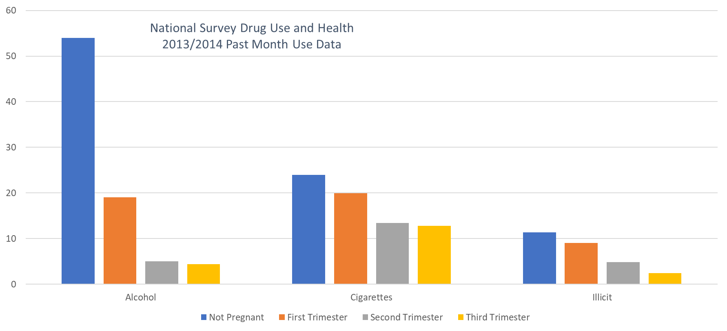
Substance Use Before and During Pregnancy
Pregnancy is a time when people are
READY TO MAKE A CHANGE
Source: SAMHSA, 2014

Slide 21
Some of the most at risk and most
READY FOR CHANGE
patients are the
LEAST LIKELY
to be able to access treatment

Slide 22
Who is at risk?

Slide 23
Why do some develop a use disorder?
SUBSTANCE USED
PERSONAL HISTORY OF ADDICTION
EARLY INITIATION OF SUBSTANCE USE
GENETICS
BRAIN CIRCIUTS
FAMILY HISTORY OF ADDICTION
ADDICTION
ENVIRONMENT
CURRENT SUBSTANCE USE
PEER USE
CHRONIC STRESS/INSTABILITY
INDIVIDUAL LIFE EXPERIENCES
HIGH ACE SCORE

Slide 24
What is addiction?

Slide 25
Diagnosis of a Use Disorder - DSM5
DSM-5 guidelines for the diagnosis of a substance use disorder require that the individual have significant impairment or distress from their pattern of drug use,
and at least two of the symptoms listed below in a 12-month period
Using more, or for longer, than planned
Inability to cut down
Spending substantial amount of the day obtaining, using, or recovering
Inability to meet important obligations
Persistent usage despite frequent problems
Giving up or cutting back on important activities
Using in physically hazardous situations, or usage causing harm
Persistent use worsening a physical or mental problem
Cravings
Tolerance
Withdrawal
CONTROL
CONSEQUENCES
MILD 2-3
MODERATE 4-5
SEVERE 6+
CRAVING
Source: APA, 2022

Slide 26
Signs of a Use Disorder – DSM5 criteria
Is there a CRAVING for use?
Continued use DESPITE harmful consequences is a
PRIMARY FEATURE
Have there been CONSEQUENCES from continued use?
Is there a loss of CONTROL?

Slide 27
Acute and Chronic Substance Use:
Pathway to Addiction AND WITHDRAWAL
ACUTE
Euphoria
Normal
Withdrawal
CHRONIC
Source: Peters et al., 2019

Slide 28
Withdrawal management IS NOT treatment
return to use after discharge from medically supervised withdrawal
65-90%
Source: Broers et al., 2000; Smyth et al., 2010

Slide 29
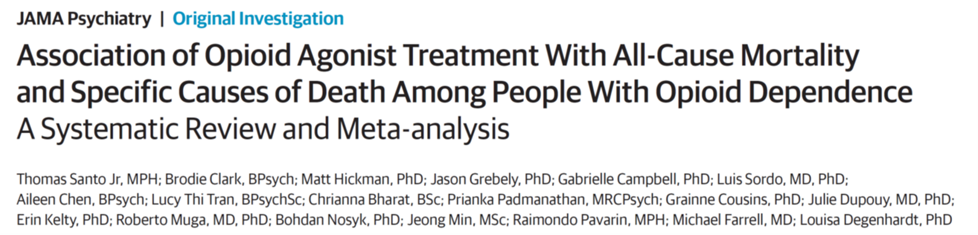
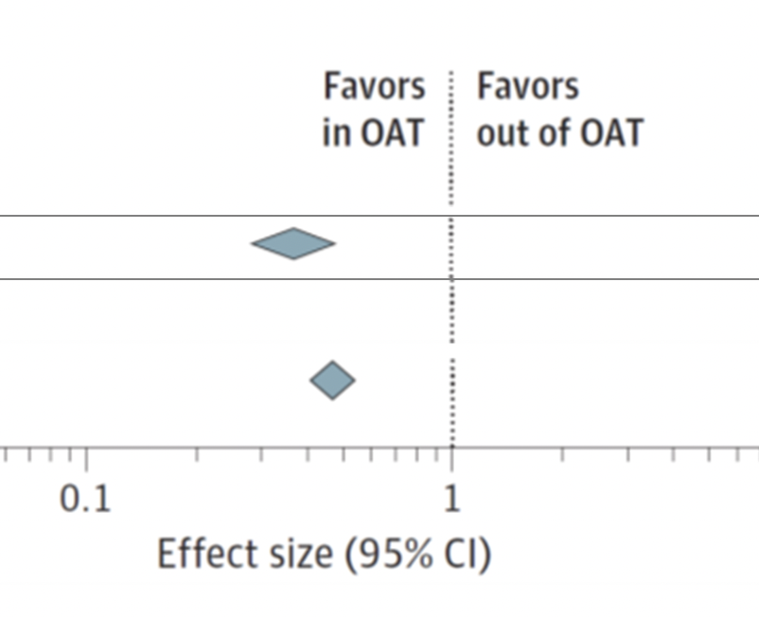
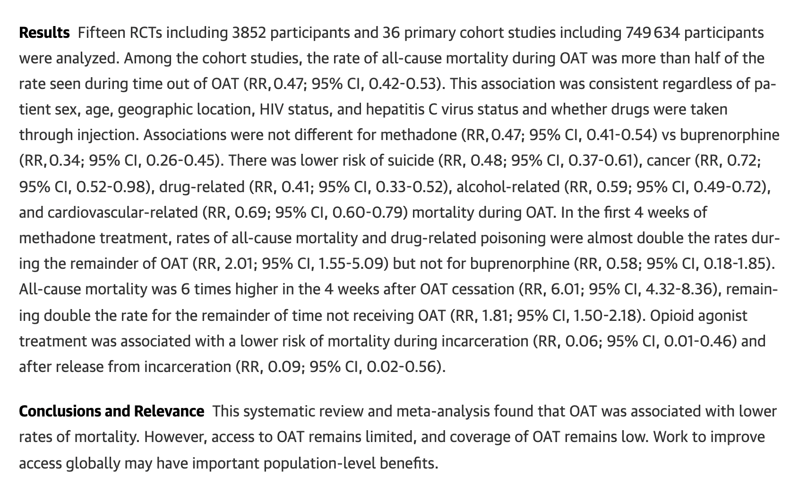
Medication for OUD SAVES LIVES
June 2, 2021
MORE THAN HALF
Buprenorphine
Methadone

Slide 30
People treated with medications for substance use disorder feel NORMAL
Euphoria
Normal
Withdrawal
Chronic use
Maintenance
Source: Peters et al., 2019

Slide 31
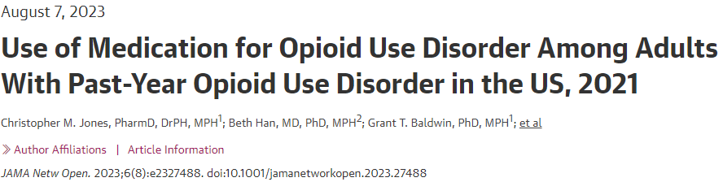
47,000+ adults
About 1 out of 5 received ANY MOUD
LESS LIKELY TO RECEIVE MOUD:
Women
African American
Non-metropolitan residence

Slide 32
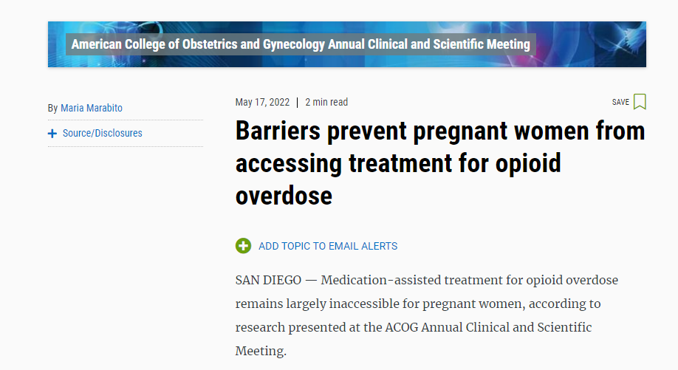
Lack of access
Phone survey of OB providers in West Virginia, Kentucky, Tennessee, and Ohio
Majority of counties had NO OB/GYN with the ability to prescribe MOUD
<15% of counties had ANY in-office prescriber of medication for opioid use disorder
LESS THAN 2%
OF OB/GYNs
HAD AN X WAIVER
Source: Rosenblatt, 2015

Slide 33
Barriers to Care

Slide 34
Stigma

Slide 35

Isn’t Addiction a Behavior?

Slide 36
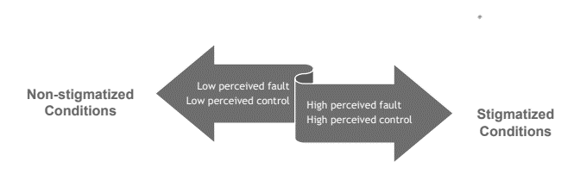
Stigma
Source: Education Development Center, 2017
Notes:
Diabetes, hypertension, and many other disease processes we treat have behavioral components

Slide 37
Factors Contributing to Stigma
Misperception SUD/OUD = moral weakness
Separation from the rest of health care
Stigmatizing Language
Criminal justice system prohibiting MOUD/other treatments – this is changing
Source: Olsen, 2014
Notes:
Separated from the rest of health care, recovery depends on moral strength, many force tapers from medications for substance use disorder; stigma of medications in 12-step treatment programs – including exclusion of such folks from treatment
Contributes to narrow focus – for example, treating OUD but not other types of addition; not treating co-occurring medical conditions; not treating
Language mirrors and perpetuates the stigma – dirty, clean, junky, opioid replacement therapy
Starting to change but long were not permitted to continue treatment.

Slide 38
What does stigmatizing language look like?
Addict
Alcoholic
Dirty urine
Junkie
Schizophrenic
Substance abuser
Clean
HIV-infected

Slide 39
Does it matter how we refer to individuals with substance related conditions?
~500 clinicians at a mental health conference
Presented with two clinical vignettes identical EXCEPT:
"having a substance use disorder"
"substance abuser"
Source: Kelly & Westerhoff, 2010
Notes:
​

Slide 40

YES, Words Matter
The "substance abuser" was...
Personally culpable
More likely to benefit from punishment, less likely to benefit from treatment
More likely to be able to control their behavior
Solution to problem was moral not medical
(Kelly & Westerhoff, 2010)

Slide 41
What does “person-centered” language look like?
Alcoholic
Dirty urine
Addict
Junkie
Patient with an alcohol use disorder
Positive toxicology/Expected or Unexpected
Someone with a substance use disorder
Junkie
Schizophrenic
Substance abuser
Someone with schizophrenia
Someone who uses substances
HIV-infected
Clean
Someone living with HIV
Abstinent

Slide 42
Person First Language
Preferred Language | Stigmatizing Language
Substance use disorder, substance use | Abuse, addiction, habit, problem
Person with a substance use disorder | Addict, alcoholic, crackhead, junkie, abuser, user
Drug monitoring, drug screen, expected/ unexpected | Dirty or clean drug test
Actively using. In recovery. Not actively using. Return to use. | Dirty, clean, sober
Medications for opioid use disorder | Drug replacement substitution therapy
Adapted from Federal Bureau of Prisons OPIOID USE DISORDER: DIAGNOSIS, EVALUATION, AND TREATMENT
Notes:
Source: Federal Bureau of Prisons OPIOID USE DISORDER: DIAGNOSIS, EVALUATION, AND TREATMENT

Slide 43
Q: Should we correct how patients/clients identify themselves or describe their experiences?
I was a drunk.
I was clean for a year.
A: No
I’m an addict.
Notes:
We do not need to correct these expressions – we should think about how words like this sound coming from us.

Slide 44
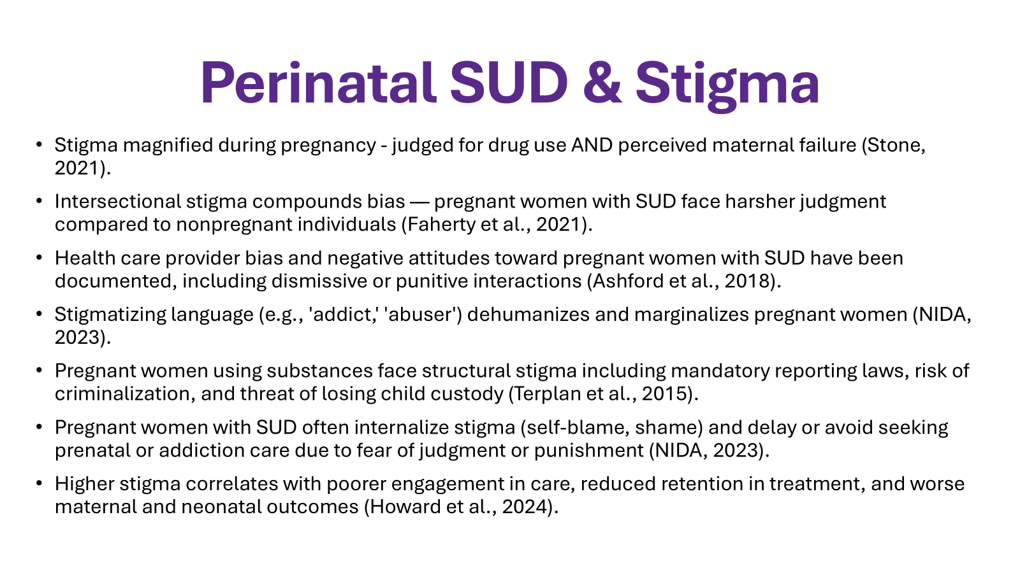
Stigma
Source: Education Development Center, 2017
Notes:
Diabetes, hypertension, and many other disease processes we treat have behavioral components

Slide 45

One woman was pregnant, using heroin, and incarcerated in her third trimester. A nurse in the jail said to the woman that she was a junkie and does not deserve to be a mother… (Interview conducted by Hendrée Jones, PhD, University of North Carolina, February 25, 2021)
The woman said to the nurse, “Lady, there is nothing you can’t say to me worse than what I have already said to myself. Are you going to judge me or help me get help?”
Your Words Matter – Language Showing Compassion and Care for Women, Infants, Families, and Communities Impacted by Substance Use Disorder
This slide is copied and modified from a presentation given to the DEA on Stigma Reduction by Judy Lavelle of NIDA August 2022

Slide 46
Integrated Substance Use and Obstetric Care

Slide 47
Evidence-Based
ACOG – ASAM – SAMHSA
stigma-free, family-centered care that recognizes the unique barriers and stressors of the perinatal period
Evidence-based perinatal OUD care includes:
integrated substance use and obstetric care
universal screening
harm reduction interventions
provider anti-stigma training
shared decision making
medications for opioid use disorder (MOUD), and
recovery support with an emphasis on the postnatal period

Slide 48
Integrated Care Model
Multiple services, one visit
Prenatal and postpartum care
Substance use disorder treatment
Mental health services
Reproductive/sexual health medical services
Recovery support
Wrap-around support services (e.g. lactation, social work)
Perinatal continuum of care
pregnancy through one year postpartum
Trainee-based care model

Slide 49

Postpartum is a VULNERABLE TIME
Disengagement from clinic visits and support systems
Multiple appointments across multiple service lines
STRESSFUL
DSS involvement, possibly with a previous traumatic experience
Infants with, or just recovering from, a withdrawal syndrome
Potential loss of insurance coverage
MS Medicaid coverage continues 12 months PP
Return to harmful or abusive relationships
~55% have underlying mental health need (e.g., depression)
RETURN TO SUBSTANCE USE

Slide 50
Who, When, Where
Who:
Confirmed pregnancy
Use Disorder (opioid, alcohol, stimulant, etc.)
In Recovery From a Use Disorder
When and Where:
Greenville, NC Brody School of Medicine (BSOM)
When: Wednesday mornings currently, with hopes to expand access
IMPACT website: https://obgyn.ecu.edu/impact/

Slide 51
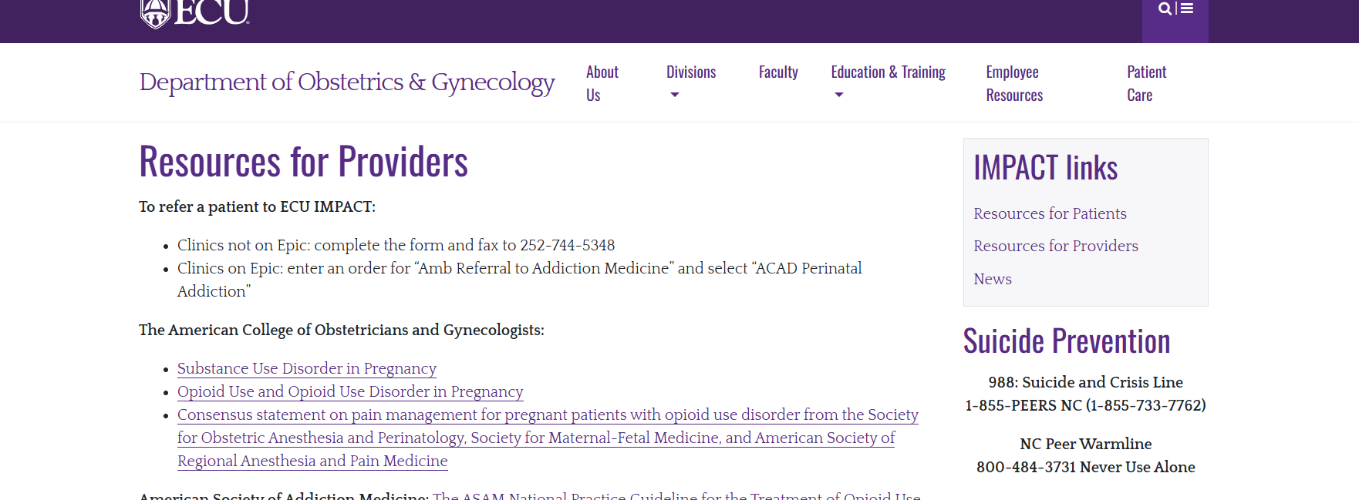
HOW TO REFER

Slide 52
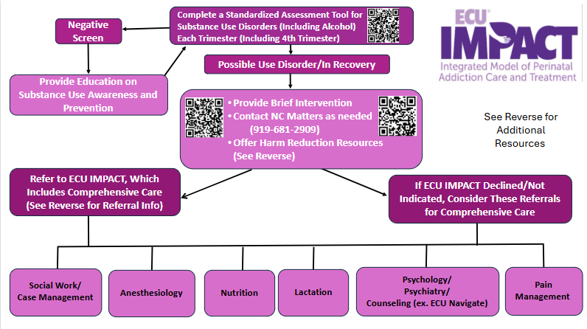
Screening & Referral (Draft)

Slide 53
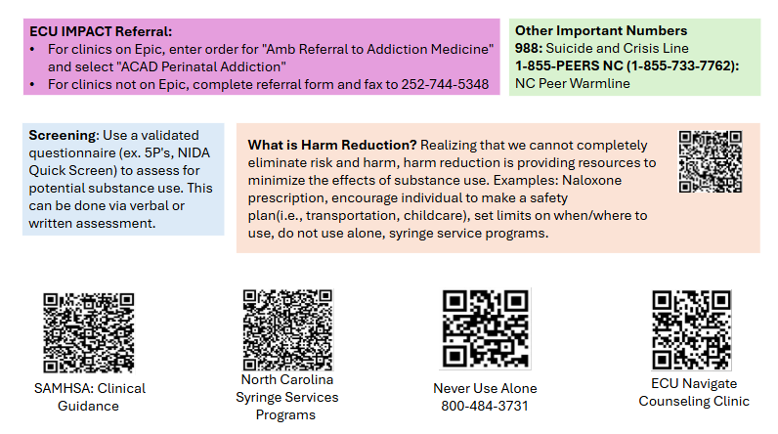
Screening & Referral (Draft)

Slide 54
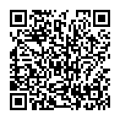
We Need Your Input, Please!
Survey
or go to https://redcap.ecu.edu/surveys/ and enter code: XHAJD9TH9

Slide 55
Final Thoughts
Addiction is a treatable, medical, and chronic disease
Pregnant patients have unique circumstances and needs, and face additional barriers to accessing treatment
Treatments needs ARE GREATER in the postpartum period, and we are failing
We can make a difference!

Slide 56
Select References
Abel, E. L., & Kruger, M. (2002). Physician attitudes concerning legal coercion of pregnant alcohol and drug abusers. American Journal of Obstetrics and Gynecology, 186(4), 768–772. https://doi.org/10.1067/mob.2002.122142
Abraham, R., Wilkinson, E., Jabbarpour, Y., & Bazemore, A. (2020). Family physicians play key role in bridging the gap in access to opioid use disorder treatment. American Family Physician, 102(1), 10.
Allen, A. M., Weinberger, A. H., Wetherill, R. R., Howe, C. L., & McKee, S. A. (2017). Oral contraceptives and cigarette smoking: A review of the literature and future directions. Nicotine & Tobacco Research, 21(5), 592-601. https://pmc.ncbi.nlm.nih.gov/articles/PMC6468133/
American College of Obstetricians and Gynecologists. (2018). ACOG committee opinion No. 736: Optimizing postpartum care. Obstetrics & Gynecology, 131(5), e140–e150. https://doi.org/10.1097/AOG.0000000000002633
American College of Obstetricians and Gynecologists. (2017). Committee opinion No. 711: Opioid use and opioid use disorder in pregnancy. https://www.acog.org/clinical/clinical-guidance/committee-opinion/articles/2017/08/opioid-use-and-opioid-use-disorder-in-pregnancy
American College of Obstetricians and Gynecologists. (2020). Opposition to criminalization of individuals during pregnancy and the postpartum period. https://www.acog.org/clinical-information/policy-and-position-statements/statements-of-policy/2020/opposition-criminalization-of-individuals-pregnancy-and-postpartum-period
American Psychiatric Association. (2022). Diagnostic and statistical manual of mental disorders (5th ed., text rev.). https://doi.org/10.1176/appi.books.9780890425787
American Society for Addiction Medicine. (2020). The ASAM national practice guideline for the treatment of opioid use disorder 2020: Focused update. https://dss.sd.gov/formsandpubs/docs/BH/BHAO02_ASAM_National_Practice_Guideline.pdf
Athey, A., Kilmer, B., & Cerel, J. (2024). An overlooked emergency: More than one in eight US adults have had their lives disrupted by drug overdose deaths. American Journal of Public Health, 114(3), 276–279. https://doi.org/10.2105/AJPH.2023.307550
Azuine, R. E., Ji, Y., Chang, H. Y., Kim, Y., Ji, H., DiBari, J., Hong, X., Wang, G., Singh, G. K., Pearson, C., Zuckerman, B., Surkan, P., & Wang, X. (2019). Prenatal risk factors and perinatal and postnatal outcomes associated with maternal opioid exposure in an urban, low‑income, multiethnic US population. JAMA Network Open, 2(6), e196405. https://doi.org/10.1001/jamanetworkopen.2019.6405
Bahji, A., Mazhar, M. N., Hudson, C. C., Nadkarni, P., MacNeil, B. A., & Hawken, E. (2019). Prevalence of substance use disorder comorbidity among individuals with eating disorders: A systematic review and meta‑analysis. Psychiatry Research, 273, 58–66. https://doi.org/10.1016/j.psychres.2019.01.011
Brasiliano, S., Kachani, A. T., Carezzato, F., & Hochgraf, P. B. (2020). Alcohol and Substance Use Disorders in Women. In J. Rennó Jr., G. Valadares, A. Cantilino, J. Mendes-Ribeiro, R. Rocha, & A. G. da Silva (Eds.), Women’s Mental Health (pp. 191-214). Springer. https://doi.org/10.1007/978-3-030-29081-8_14
Broers, B., Giner, F., Dumont, P., & Mino, A. (2000). Inpatient opiate detoxification in Geneva: follow-up at 1 and 6 months. Drug and Alcohol Dependence, 58(1-2), 85-92. https://pubmed.ncbi.nlm.nih.gov/10669058/

Slide 57
Select References
Bruzelius, E., Underhill, K., Askari, M. S., Kajeepeta, S., Bates, L., Jarlenski, M., Martins, S. S. (2024). Punitive legal responses to prenatal drug use in the United States: A survey of state policies and systematic review of their public health impacts. International Journal of Drug Policy, 126, 104380. https://pmc.ncbi.nlm.nih.gov/articles/PMC9060417/
Bruzelius, E., & Martins, S. S. (2022). US trends in drug overdose mortality among pregnant and postpartum persons, 2017–2020. The Journal of the American Medical Association, 328(21), 2159–2161. https://doi.org/10.1001/jama.2022.17045
Centers for Disease Control and Prevention (CDC). (2022). OD2A case study: harm reduction. https://www.cdc.gov/overdose-prevention/php/od2a/harm-reduction.html
Centers for Disease Control and Prevention. (2025a). Alcohol use and your health. https://www.cdc.gov/alcohol/about-alcohol-use/index.html
Centers for Disease Control and Prevention. (2025b). Provisional drug overdose death counts. https://www.cdc.gov/nchs/nvss/vsrr/drug-overdose-data.htm
Centers for Disease Control and Prevention. (2025c). Understanding the opioid overdose epidemic. https://www.cdc.gov/overdose-prevention/about/understanding-the-opioid-overdose-epidemic.html
Children and Recovering Mothers (CHARM). (2023 October 31). A roadmap to implementation in New York State. https://www.acog.org/community/districts-and-sections/district-ii/programs-and-resources/medical-education/opioid-use-disorder-in-pregnancy/children-and-recovering-mothers-charm-a-roadmap-to-implementation-in-new-york-state
Clemans-Cope, L., Lynch, V., Howell, E., Hill, I., Holla, N., Morgan, J., Johnson, P., Cross-Barnet, C., & Thompson, J. A. (2019). Pregnant women with opioid use disorder and their infants in three state Medicaid programs in 2013–2016. Drug and Alcohol Dependence, 195, 156-163. https://doi.org/10.1016/j.drugalcdep.2018.12.005
Drug Enforcement Agency. (n.d.). One pill can kill. https://www.dea.gov/onepill
Dube, S. R., Felitti, V. J., Dong, M., Chapman, D. P., Giles, W. H., & Anda, R. F. (2003). Childhood abuse, neglect, and household dysfunction and the risk of illicit drug use: The Adverse childhood experiences study. Pediatrics, 111(3), 564–572. https://doi.org/10.1542/peds.111.3.564
Education Development Center. (2017). Words matter: How language choice can reduce stigma. Developed under the Substance Abuse and Mental Health Services Administration’s Center for the Application of Prevention Technologies task order. Reference #HHSS283201200024I/HHSS28342002T. https://solutions.edc.org/sites/default/files/Words-Matter-How-Language-Choice-Can-Reduce-Stigma_0.pdf
Federal Bureau of Prisons. (2021). Clinical guidance: Opioid use disorder: Diagnosis, evaluation, and treatment. https://www.bop.gov/resources/pdfs/opioid_use_disorder_cg.pdf
Felitti, V. J., Anda, R. F., Nordenberg, D., Williamson, D. F., Spitz, A. M., Edwards, V., Koss, M. P., & Marks, J. S. (1998). Relationship of childhood abuse and household dysfunction to many of the leading causes of death in adults: The ACE Study. American Journal of Preventive Medicine, 14(4), 245–258. https://www.ajpmonline.org/article/S0749-3797(98)00017-8/pdf

Slide 58
Select References
Gaither, J. R., Gordon, K., Crystal, S., Edelman, E. J., Kerns, R. D., Justice, A. C., Fiellin, D. A., & Becker, W. C. (2018). Racial disparities in discontinuation of long‑term opioid therapy following illicit drug use among Black and White patients. Drug and Alcohol Dependence, 192, 371–376. https://doi.org/10.1016/j.drugalcdep.2018.05.033
Garnett, M. F., & Miniño, A. M. (2024). Drug overdose deaths in the United States, 2003–2023. NCHS Data Brief (No. 522). National Center for Health Statistics. https://doi.org/10.15620/cdc/170565
Gibbons, J. B., McCullough, J. S., Zivin, K., Brown, Z. Y., & Norton, E. C. (2024). Racial and ethnic disparities in medication for opioid use disorder access, use, and treatment outcomes in Medicare. Journal of Substance Use and Addiction Treatment, 157, 209271. https://doi.org/10.1016/j.josat.2023.209271
Goodman, D. J., Saunders, E. C., Frew, J. R., Arsan, C., Xie, H., Bonasia, K. L., Flanagan, V. A., Lord, S. E., & Brunette, M. F. (2022). Integrated vs nonintegrated treatment for perinatal opioid use disorder: Retrospective cohort study. American Journal of Obstetrics & Gynecology MFM, 4(1), 100489. https://doi.org/10.1016/j.ajogmf.2021.100489
Grant, B. F., Goldstein, R. B., Saha, T. D., Chou, S. P., Jung, J., Zhang, H., Pickering, R. P., Ruan, J., Smith, S., Huang, B., & Hasin, D. S. (2015). Epidemiology of DSM-5 alcohol use disorder: results from the National Epidemiologic Survey on Alcohol and Related Conditions III. JAMA Psychiatry, 72(8), 757-766. https://jamanetwork.com/journals/jamapsychiatry/fullarticle/2300494
Hawk, M., Coulter, R. W. S., Egan, J. E., Fisk, S., Friedman, M. R., Tula, M., & Kinsky, S. (2017). Harm reduction principles for healthcare settings. Harm Reduction Journal, 14(70). https://harmreductionjournal.biomedcentral.com/articles/10.1186/s12954-017-0196-4
Jarlenski, M., Shroff, J., Terplan, M., Roberts, S. C. M., Brown-Podgorski, B., & Krans, E. E. (2023). Association of race with urine toxicology testing among pregnant patients during labor and delivery. JAMA Health Forum, 4(4), e230441. https://jamanetwork.com/journals/jama-health-forum/fullarticle/2803729
Jones, C. M., Han, B., Baldwin, G. T., Einstein, E. B., & Compton, W. M. (2023). Use of medication for opioid use disorder among adults with past-year opioid use disorder in the US, 2021. JAMA Network Open, 6(8), e2327488. https://doi.org/10.1001/jamanetworkopen.2023.27488
Kelly, J. F., & Westerhoff, C. M. (2010). Does it matter how we refer to individuals with substance‑related conditions? A randomized study of two commonly used terms. International Journal of Drug Policy, 21(3), 202–207. https://doi.org/10.1016/j.drugpo.2009.10.010
Khan, S. S., Okuda, M., Hasin, D. S., Secades-Villa, R., Keyes, K., Lin, K-H., Grant, B., & Blanco, C. (2013). Gender differences in lifetime alcohol dependence: Results from the National Epidemiologic Survey on Alcohol and Related Conditions. Alcoholism: Clinical and Experimental Research, 37(10), 1696–1705. https://pubmed.ncbi.nlm.nih.gov/23763329/
Khan, S. S., Secades‑Villa, R., Okuda, M., Wang, S., Perez-Fuentes, G., Kerridge, B. T., & Blanco, C. (2013). Gender differences in cannabis use disorders: Results from the National Epidemiologic Survey on Alcohol and Related Conditions. Drug and Alcohol Dependence, 130(1–3), 101–108. https://doi.org/10.1016/j.drugalcdep.2012.10.015

Slide 59
Select References
Kirsch, D. E., Belnap, M. A., Kady, A., & Raya, L. A. (2025). A narrative review on alcohol use in women: Insight into the telescoping hypothesis from a biopsychosocial perspective. American Journal of Drug and Alcohol Abuse, 51(1), 14–30. https://doi.org/10.1080/00952990.2024.2419540
Kropp, F. B., Smid, M. C., Lofwall, M. R., Wachman, E. M., Martin, P. R., Murphy, S. M., Wilder, C. M., & Winhusen, T. J. (2023). Collaborative care programs for pregnant and postpartum individuals with opioid use disorder: Organizational characteristics of sites participating in the NIDA CTN0080 MOMs study. Journal of Substance Use and Addiction Treatment, 149, 209030. https://doi.org/10.1016/j.josat.2023.209030
Latimore, A., Hinojosa, A. O., Kestner, L., & Patel, P. (2021). Exploring urban-rural disparities in accessing treatment for opioid use disorder. Advancing Evidence. Improving Lives. American Institutes for Research. https://www.air.org/resource/field/exploring-urban-rural-disparities-accessing-treatment-opioid-use-disorder
Lieberman, A., Dennis, A., & Davis, C. (2024). Harm reduction laws in the United States. The Network for Public Health Law. https://www.networkforphl.org/resources/harm-reduction-laws-in-the-united-states/
Martin, C. E., & Parlier‑Ahmad, A. B. (2021). Addiction treatment in the postpartum period: An opportunity for evidence‑based personalized medicine. International Review of Psychiatry, 33(6), 579–590. https://doi.org/10.1080/09540261.2021.1898349
Mayet, S., Groshkova, T., Morgan, L., MacCormack, T., & Strang, J. (2008). Drugs and pregnancy—outcomes of women engaged with a specialist perinatal outreach addictions service. Drug and Alcohol Review, 27(5), 497–503. https://doi.org/10.1080/09595230802245261
Meinhofer, A., Hinde, J. M., & Ali, M. M. (2020). Substance use disorder treatment services for pregnant and postpartum women in residential and outpatient settings. Journal of Substance Abuse Treatment, 110, 9–17. Retrieved July 7, 2025, from https://doi.org/10.1016/j.jsat.2019.12.005
Miles, J., Treitler, P., Hermida, R., Nyaku, A. N., Simon, K., Gupta, S., Crystal, S., & Samples, H. (2023). Racial/ethnic disparities in timely receipt of buprenorphine among Medicare disability beneficiaries. Drug and Alcohol Dependence, 252, 110963. https://doi.org/10.1016/j.drugalcdep.2023.110963
National Institute on Drug Abuse (NIDA). (2020, January). Substance use in women. U.S. Department of Health and Human Services. https://nida.nih.gov/sites/default/files/18910-substance-use-in-women_1.pdf
Never Use Alone. (2024 March 30). https://neverusealone.com/
North Carolina Department of Health and Human Services (NCDHHS). (2021). Opioid and substance use action plan data dashboard. Retrieved July 7, 2025, from https://www.ncdhhs.gov/opioid-and-substance-use-action‑plan-data-dashboard

Slide 60
Select References
North Carolina Department of Health and Human Services (NCDHHS). (2025). North Carolina 2018-2020 maternal mortality review report: August 2025. https://www.dph.ncdhhs.gov/women-infant-and-community-wellness/mmrcreportwebpdf/open
North Carolina Department of Health and Human Services (NCDHHS). (2023). NC Safer Syringe Initiative Annual Report, 2022-2023. https://www.ncdhhs.gov/nc-safer-syringe-initiative-annual-report-2022-2023/download?attachment
North Carolina Department of Health and Human Services (NCDHHS). (2025). Syringe services program in North Carolina. https://www.ncdhhs.gov/divisions/public-health/north-carolina-safer-syringe-initiative/syringe-services-program-north-carolina
Olsen, Y., & Sharfstein, J. M. (2014). Confronting the stigma of opioid use disorder—and its treatment. JAMA, 311(14), 1393–1394. https://doi.org/10.1001/jama.2014.2147
Ordean, A., Kahan, M., Graves, L., Abrahams, R., & Boyajian, T. (2013). Integrated care for pregnant women on methadone maintenance treatment. Canadian Family Physician, 59(10), e462–e469. https://www.ncbi.nlm.nih.gov/pmc/articles/PMC3796993/
Patton, E. W., Saia, K., & Stein, M. D. (2021). Integrated substance use and prenatal care delivery in the era of COVID‑19. Journal of Substance Abuse Treatment, 124, 108273. https://doi.org/10.1016/j.jsat.2020.108273
Peters, W., Guille, C., & Mittal, L. (2019). Substance Use Disorders in Women. In M. A. O’Neal (Ed.), Neurology and Psychiatry of Women (pp. 103-113). Springer. https://doi.org/10.1007/978-3-030-04245-5
Quick‑Graham, L., Jones, B., Moore‑Patterson, R., & Sheffield‑Abdullah, K. (2023). A closer look at preventable pregnancy‑associated deaths due to opioid overdose in North Carolina. North Carolina Medical Journal, 84(1). https://doi.org/10.18043/001c.6778
Rao, T., & Lattimore, A. (2021). Exploring urban‑rural disparities in accessing treatment for opioid use disorder. American Institutes for Research. Retrieved April 8, 2024, from https://www.air.org/resource/equity-focus/exploring-urban-rural-disparities-accessing-treatment-opioid-use-disorder
Reed, M. K., Guth, A., Salcedo, V. J., Hom, J. K., & Rising, K. L. (2022). “You can’t go wrong being safe”: Motivations, patterns, and context surrounding use of fentanyl test strips for heroin and other drugs. The International Journal of Drug Policy, 103, 103643. https://doi.org/10.1016/j.drugpo.2022.103643
Richelle, L., Dramaix-Wilmit, M., Roland, M., & Kacenelenbogen, N. (2022). Factors influencing medical students’ attitudes towards substance use during pregnancy. BMC Medical Education, 22, 335. https://pmc.ncbi.nlm.nih.gov/articles/PMC9060417/
Rosenblatt, R. A., Andrilla, H. A., Catlin, M., & Larson, E. H. (2015). Geographic and specialty distribution of US physicians trained to treat opioid use disorder. Annals of Family Medicine, 13(1), 23-26. https://www.annfammed.org/content/13/1/23

Slide 61
Select References
Santo, T., Clark, B., Hickman, M., Grebely, J., Campbell, G., Sordo, L., Chen, A., Tran, L. T., Bharat, C., Padmanathan, P., Cousins, G., Dupouy, J., Kelty, E., Muga, R., Nosyk, B., Min, J., Pavarin, R., Farrell, M., & Degenhardt, L. (2021). Association of opioid agonist treatment with all-cause mortality and specific causes of death among people with opioid dependence: A systematic review and meta-analysis. JAMA Psychiatry (Chicago, Ill.), 78(9), 979-993. https://doi.org/10.1001/jamapsychiatry.2021.0976
Santoro, T. N., & Santoro, J. D. (2018). Racial bias in the US opioid epidemic: A review of the history of systemic bias and implications for care. Cureus, 10(12), e3733. https://doi.org/10.7759/cureus.3733
Schiff, D. M., Nielsen, T., Terplan, M., Hood, M., Bernson, D., Diop, H., Bharel, M., Wilens, T. E., LaRochelle, M., Walley, A. Y., & Land, T. (2018). Fatal and nonfatal overdose among pregnant and postpartum women in Massachusetts. Obstetrics & Gynecology 132 (2), 466-474. https://journals.lww.com/greenjournal/Abstract/2018/08000/Fatal_and_Nonfatal_Overdose_Among_Pregnant_and.26.aspx
Smid, M. C., Stone, N. M., Baksh, L., Debbink, M. P., Einerson, B. D., Varner, M. W., Gordon, A. J., & Clark, E. A. S. (2019). Pregnancy‑associated death in Utah: Contribution of drug‑induced deaths. Obstetrics & Gynecology, 133(6), 1131–1140. https://doi.org/10.1097/AOG.0000000000003279
Smyth BP, Barry J, Keenan E, & Ducray K. Lapse and relapse following inpatient treatment of opiate dependence. Irish Medical Journal. 2010 Jun;103(6):176-9. PMID: 20669601
Suarez, E.A., Huybrechts, K.F., Straub, L., Hernandez-Diaz, S., Creanga, A.A., Connery, H. S., Gray, K. J., Vine, S. M., Jones, H. E., & Bateman, B. T. (2023). Postpartum Opioid-Related Mortality in Patients With Public Insurance. Obstetrics & Gynecology 141(4):p 657-665. https://pubmed.ncbi.nlm.nih.gov/36897177/
Substance Abuse and Mental Health Services Administration (SAMHSA). (n.d.-a). Clinical guidance for treating pregnant and parenting women with opioid use disorder and their infants. Retrieved January 24, 2024, from https://store.samhsa.gov/product/clinical-guidance‑treating‑pregnant‑and‑parenting‑women‑opioid‑use‑disorder‑and‑their
Substance Abuse and Mental Health Services Administration (SAMHSA). (n.d.-b). A collaborative approach to the treatment of pregnant women with opioid use disorders. Retrieved January 23, 2024, from https://store.samhsa.gov/product/collaborative-approach-treatment-pregnant-women-opioid-use-disorders/sma16-4978
Substance Abuse and Mental Health Services Administration. (n.d.-c). Buprenorphine treatment practitioner locator. Retrieved April 15, 2024, from https://www.samhsa.gov/medication-assisted-treatment/find-treatment/treatment-practitioner-locator
Substance Abuse and Mental Health Services Administration. (n.d.-d). Opioid treatment program locator. Retrieved April 15, 2024, from https://dpt2.samhsa.gov/treatment/
Substance Abuse and Mental Health Services Administration (SAMHSA). (2014). Results from the 2013 National Survey on Drug Use and Health: Summary of national findings. (NSDUH Series H‑48, HHS Publication No. (SMA) 14‑4863).

