Slide 1
Western Virtual Regional Meeting December 4, 2020
Presented by NC DHHS Business Operations
Local Business Liaisons & Fiscal Monitors

Slide 2
Agenda
New Funding Related to COVID-19
FY 19-20 Results
FY 20-21 Current Status
NC-CoReLS
Virtual Visits
Fiscal Monitoring
Odds & Ends
Upcoming Meetings/Trainings

Slide 3
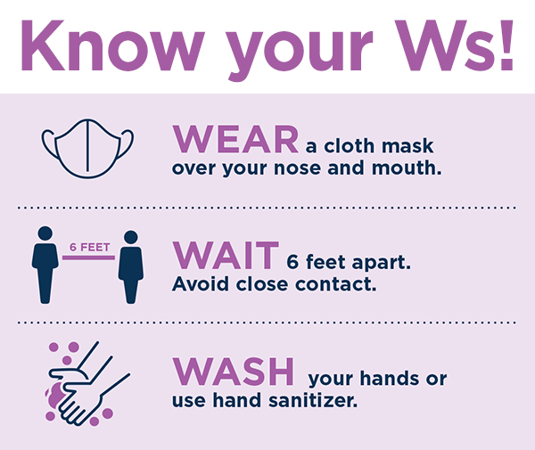
COVID-19
Additional Funding for:
APS/CPS, Foster Care, & LINKS
Must be expensed/encumbered between March 1, 2020 - December 30, 2020
DCDL dates 6/15/2020, 7/16/2020, 8/28/2020, & 9/16/2020
UPDATE: Effective 9/16/20, funds shifted from reimbursement to an advance.
APS/CPS cost claimed via 1571 as non-reimbursable
No ADP or Direct Charge Letter required
Was this cost already claimed to COVID???
Documentation & Reconciliation is Key!
UPDATE: Foster Care monthly $100 supplemental payment was shifted to an advance and extended through 9/2020. See DCDL dated 9/22/2020. Submit questions to Tina.Bumgarner@dhhs.nc.gov.
LINKS COVID-19 Funds reimbursed by form submitted to linksreimbursement@dhhs.nc.gov. Submit questions to Erin.Conner@dhhs.nc.gov. (No process change)

Slide 4
Fiscal Year 19-20 Results Plan now for year end. Try not to make corrections in the May 1571 uploaded in June.
Did you meet MOE? Did you spend all your capped allocations?
Did you have to submit a letter?
Were you able to pull in additional capped funding?
Were you prepared?

Slide 5
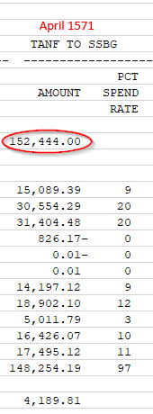
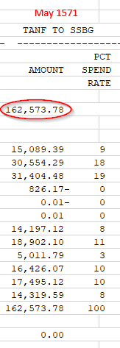
How to know if you received additional capped funds at Fiscal Year End
Compare the Annual Allocation amounts from April State XS411 to the May XS411

Slide 6
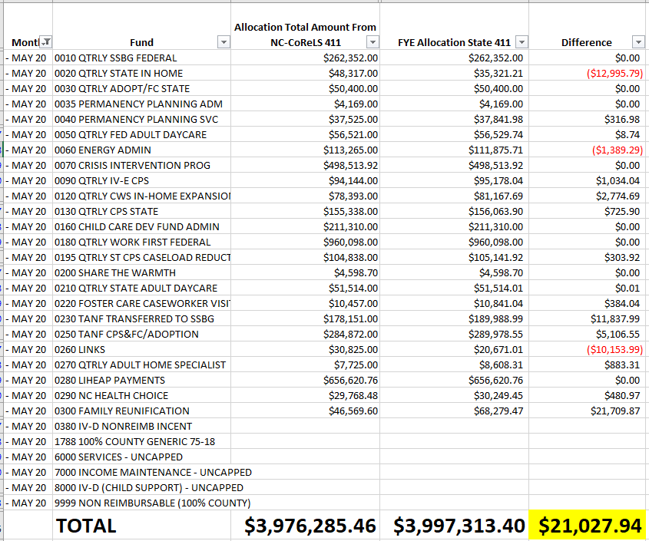
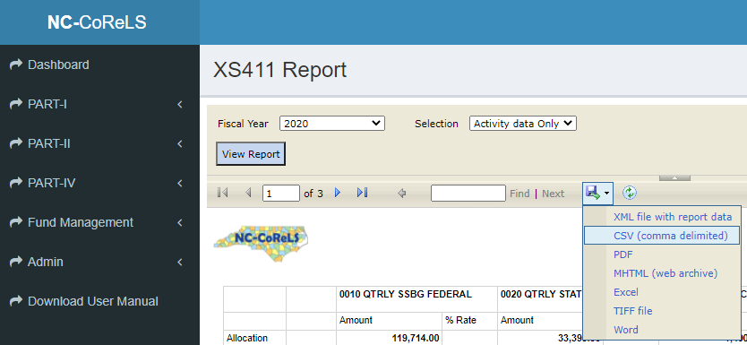
Quick glance…downloading NC-CoReLS to .csv

Slide 7
Fiscal Year 20-21 Current Status
November service month reported on December 1571 is the end of the second quarter.
Things to check for…
Were quarterly allocations overspent?
Were “0” funds utilized before “R”?
Links – do you have a plan – expenses or daysheet coding?
Family Reunification – expenses or daysheet coding?
MOE and TANF tracking/Both are tracked on NC-CoReLS XS411

Slide 8
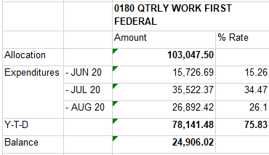
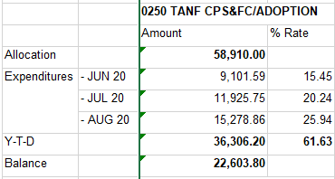
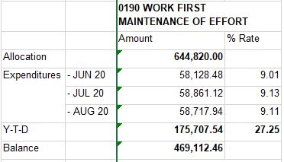
Example of what to review: TANF & MOE
Program Code “R”
Program Code “0” (zero)
Best practice is to review the 411 report monthly for allowable admin shifts after processing allocations, but before transferring the 1571.
Program Code “9” (MOE)
Notice how the county utilized the 0 funds first because it is an annual allocation. This allows R funding to build since it is a quarterly allocation. This will assist in preventing the county to overspend in the first quarter.
Also notice they are starting the beginning of the year in spending their MOE and spending steadily.

Slide 9
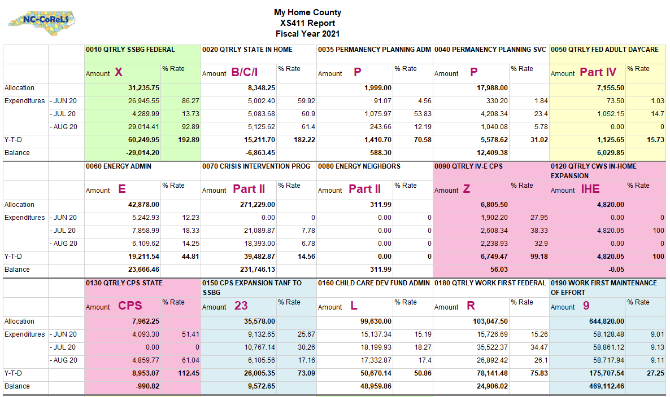

Slide 10
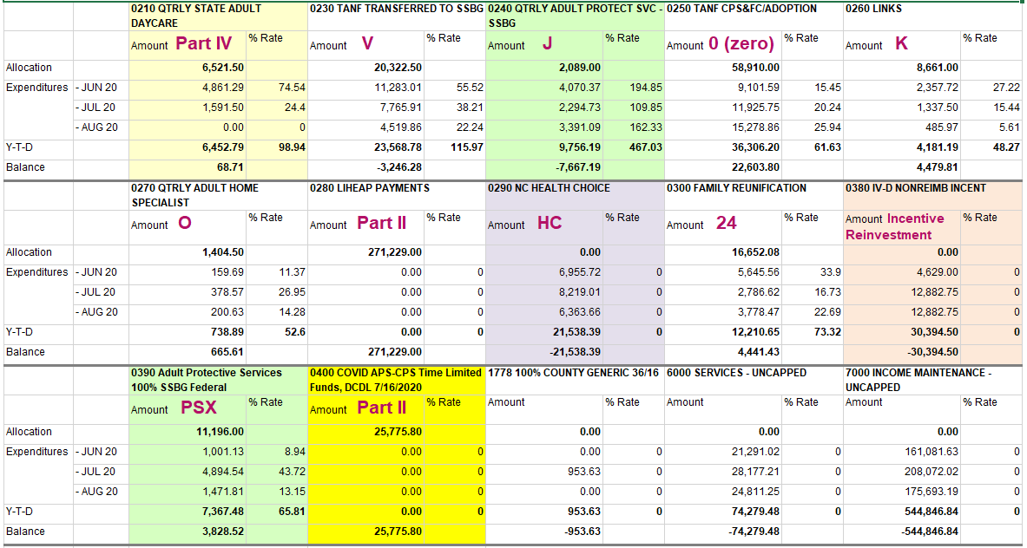

Slide 11
NC-CoReLS
Process Allocations –
Now REQUIRED prior to uploading
Are you checking the Effort Detail option “Multiple Import Sources”?
DHHS.CORELS.SUPPORT@dhhs.nc.gov

Slide 12
Virtual Visits
It is very important to us that we continue to give counties the support needed during these challenging times.
Microsoft Teams is a great resource for us to be able to carry out our virtual visits.
We also have a conference call line we can utilize when needed.
We will continue to offer Virtual Fiscal Trainings.
Please give us feedback…it does help for future events!

Slide 13
Fiscal Monitoring
Virtual Visits
Balancing General Ledger
Current Indirect Cost Plan
Excel Spreadsheets
FTE’s
Daysheets
Reconciling NCHC & HCWD Fees
Entrance & Exit Conferences

Slide 14
New FNS Employment & Training Coordinator is Dashawn Page Dashawn.Page@dhhs.nc.gov
NCXCloud – All users are encouraged to use the new system. Removal of XTND & XNET has been postponed.
Training modules – https://it.nc.gov/sysware
Level 1 Support – County Help Desk (county staff that sets up RACF or managed XNET/XTND)
Level 2 Support – Contact DIT Help Desk through Service Now ticket DIT Service Now (Mainframe – Tools) and requires your NCID or call 919-754-6000
Keep a watch out for our monthly newsletter!
Always reference your Fiscal and SIS Manuals
Daysheet codes for Admin Staff
Combined Funding Authorizations / DAAS Funding Authorization
WF EA Counts – send to LBL monthly
MAC Training
Hurricane Season
Data Breaches
Family First Prevention Services Act (FFPSA) / County Administrative Reimbursement System (CARS)
Odds & Ends

Slide 15
Upcoming Meetings/Trainings
Central Regional Meeting – Virtual
February 18-19, 2020
Eastern Regional Meeting
March 18-19, 2020
Western Regional Meeting
March 25-26, 2020
New Fiscal Officer Trainings forthcoming in January!
Mark your calendar!

Slide 16
Need Assistance?
Local Business Liaisons
Pamela Bell
Pamela.Bell@dhhs.nc.gov
Joyce Blackburn
Joyce.Blackburn@dhhs.nc.gov
Margaret Faircloth Margaret.Faircloth@dhhs.nc.gov
Jennifer Gonzales Jennifer.Gonzales@dhhs.nc.gov
Pam Graham
Pamela.Graham@dhhs.nc.gov
Caroline Hedrick
Caroline.Hedrick@dhhs.nc.gov
Jane Long
Jane.Long@dhhs.nc.gov
Fiscal Monitors
Regina French
Regina.French@dhhs.nc.gov
Charles Robertson
Charles.Robertson@dhhs.nc.gov
Our team will be glad to help!

Slide 17
QUESTIONS???

