Slide 1

Prevention Programs
Wilson County DSS
Don Hicks, Program Manager
Kimberly Irvine, Director

Slide 2

Family Systems Work Alternatives for Families Cognitive Behavioral Therapy [AFCBT] Alternatives for Families Parenting [AFP] Prevention/Family Support Clinical Services

Slide 3
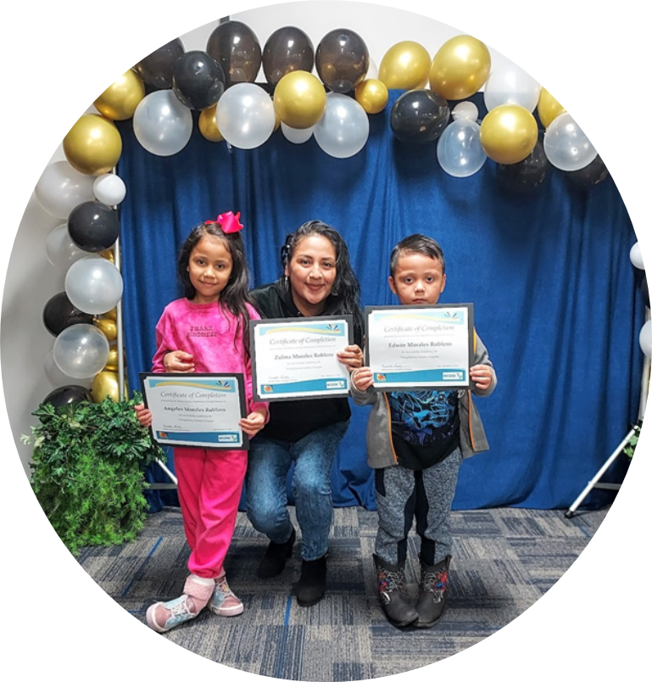
Parenting Education Options
Strengthening Families Parenting Group [Both English and Spanish]
Triple P Group level 4
Parenting Coordinator
Intensive Family Preservation
Prevention Case Management
Direct MOU with local schools
Education for Community

Slide 4

Clinical Therapy Options
Certified in numerous Evidence Based Therapeutic Interventions
Individual Therapy for Adult or Child
Trauma Intensive Comprehensive Clinical Assessment [TICCA]
Clinical Consults

Slide 5

Health Consultations
Nurse position
Help with medically fragile, failure to thrive and SAI infants
Consultation during CFTs and Parenting Classes
Education on Over-The-Counter[OTC] meds

