Slide 1
North Carolina: Poverty & The Safety Net

Slide 2
Almost 1 in 3 North Carolinians lived below 200% of the poverty line in 2019
Source: American Community Survey 2019 1-year estimates, Tables B17002
Notes:
While 14% of north Carolinians were living in poverty
We know poverty increases in downturns-and the economy often takes years to stabilize-cash assistance, of course can speed up that stabilization.
Last year at this time, about 42% of north Carolinians fell below the living income standard, and around the same percentage did not have enough liquid assets and savings to make it 3 months with no income
11.1% of North Carolinians did not have health insurance.
Rent was unaffordable for 52.9% of renters.
The richest 5% of households made an average of 28 times more than the poorest 20% of households.

Slide 3
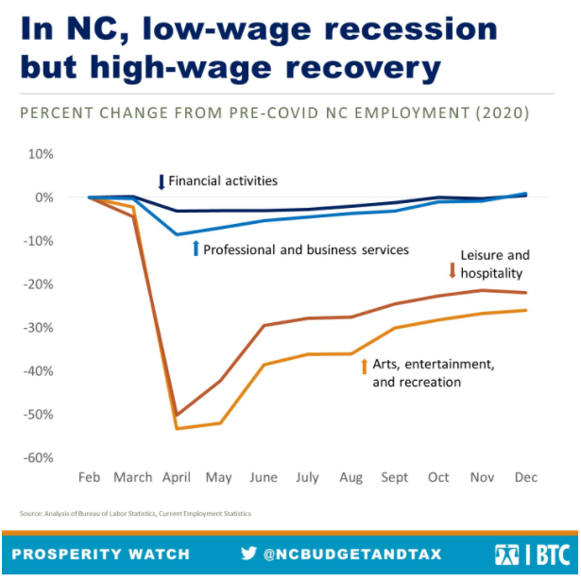
Notes:
COVID-19 is creating outsized suffering for low-wage workers, women, and people of color, but the magnitude of the economic disconnect is still often under-appreciated. In two short months from February to April of last year, nearly 270,000 leisure and hospitality jobs (roughly half of the positions in North Carolina) vanished. Most of the people who were put out of work had been getting paid meager wages and had little financial cushion to fall back on. A long history of occupational segregation and barriers to lucrative careers also meant women and people of color were particularly likely to have their livelihoods disappear. On the other end of the wage scale, North Carolinians working in finance, business services, technology, and other white collar positions saw their daily lives upended, but many were able to shift to working remotely and most kept pulling down good paychecks. Even at the worst of the recession, 9 out of every 10 professional and business services workers were still on the job, and only 3 percent of people in finance were out of work
As different as the immediate impacts were, the divide is in many ways even more dramatic today. The recession was effectively over for the best paid North Carolinians by the later part of 2020, but our worst-paid workers are still stuck in a devastating economic hole. By the end of last year, all of the jobs lost to COVID-19 in Professional and Business Services had been recovered while one-fifth of the pre-pandemic jobs (117,500) in Leisure and Hospitality are still missing.

Slide 4
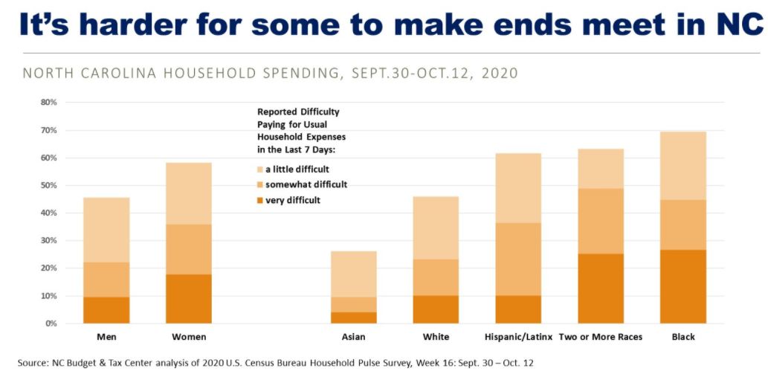

Slide 5
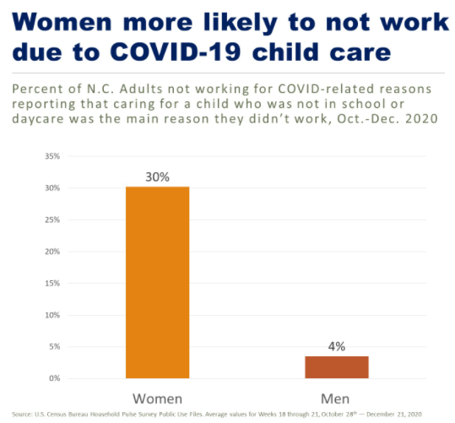

Slide 6
Hardship is widespread during COVID-19
Source: U.S. Census Bureau Household Pulse Survey Phase 2, Food Table 2b
Notes:
Snapshot of need during COVID
SNAP participation up significantly
Household pulse survey to understand hardship (housing, food insecurity) during the pandemic

Slide 7
Safety net programs cut poverty in half
Each year in North Carolina:
1,420,000 people lifted above poverty level
50% reduction in poverty
1,457,000 people lifted out of deep poverty
76% reduction in deep poverty
Source: Center on Budget and Policy Priorities calculations based on the Supplemental Poverty Measure. Based on 2013-2017 average

Slide 8
A bridge from poverty to financial stability
TANF-increase benefit; revamp subsidized employment
Increase access to UI and extend and increase the benefit
Increase SNAP by 15 percent and extend the benefit for those who cannot find a job
Expand Medicaid
Bring back the EITC
Adequately fund the childcare subsidy program
Notes:
•TANF: No increase in TANF benefit since before 1996 when the program started
•Unemployment Insurance: Average out of work 25 weeks, but maximum weeks allowed 13, benefit $250 less than in 2013 on average, 1 out of 10 jobless North Carolinians access the benefit vs. 4 out of 10 in 2013.
•SNAP: ban on NC seeking a waiver to extend the time limit for people without children or disabilities to keep SNAP while looking for a job-even in times of economic downturn and even in areas of the state with high unemployment; SNAP felony ban; standard medical expense deduction waiver
•Medicaid: Failure to expand Medicaid
•Childcare subsidy: At least 50,000 on waitlist because money used to supplant other underfunded programs
EITC: North Carolina eliminated the state-level program as part of the 2013 tax changes

Slide 9
Increasing resiliency to boost our recovery
Profile of a typical client pre-COVID?
How has that changed?
What COVID procedure changes most benefitted clients?
What policies do you suggest to create a bridge from poverty to financial stability?

Slide 10
CONTACT
Heba@ncjustice.org
VISIT
www.NCBudgetAndTax.org

