Slide 1
NC Department of Health and Human Services
Division of Social Services
Policy Updates
Kathy Stone
Section Chief for Safety
January 2026

Slide 2

Incarcerated and Pregnant Parent Policy Updates

Slide 3
Updates to Pregnancy Services Policy
Child Welfare Manual Tab https://policies.ncdhhs.gov/divisional-n-z/social-services/child-welfare-services/cws-policies-manuals/
  Appendix 4 Pregnancy Services, changes beginning on pg. 25
Primary change is to Home Study requests from the NC Department of Adult Corrections (DOAC)
  Removal of DSS-5278 Request for Placement Evaluation for Infant Born to an Incarcerated Mother
  Alignment with 7B statute; Child Welfare does not have jurisdiction prior to birth of a child
This policy does not impact out of state courtesy requests per ICPC Regulation III.

Slide 4
Changes to Home Study Requests
The DOAC assists the mother in making decisions regarding the choice of placement options. (G.S. 148-47)
  Maintains rights of the parent to make a plan for their child
The DOAC may contact the local county child welfare agency in the county where the mother resided prior to incarceration, once the child is born, IF there are concerns for dependency or maltreatment.
The local county child welfare agency is responsible for screening all child protective services reports to determine what further action is required. All screened-in cases will be managed per statute and policy.
  The local county child welfare agency is not responsible for Home Studies

Slide 5

System Changes to Child Fatality Process

Slide 6

Previous Intensive Child Fatality Review Process
County sent Fatality notification to NCDHHS DSS within 5 Business days via eFax
Once received, information to determine if it meets the criteria for Intensive Child Fatality Review was gathered (CFC had 30 days to make determination or request additional information)
Criteria-Suspicion of abuse/neglect has contributed to the child’s death
  In depth review (ICFR) any child fatalities involving children and families involved with the local county child welfare agency within the12 months preceding the death.
Notes:
Citizen Review Panels have been outsourced to HMA; 3 regional teams

Slide 7

Previous Intensive Child Fatality Review Process continued…
Determination for ICFR
  The Child Fatality Consultant would contact the county, LE and OCME, if needed, for clarification regarding the circumstances surrounding the death.
Decision
  Screening decision based on criteria and information gathered
  Decision for reviews impacted by pending information, DA, and court orders County Director informed of the decision and process via Letter/E-mail
Notes:
Citizen Review Panels have been outsourced to HMA; 3 regional teams

Slide 8
Previous Intensive Child Fatality Review Process continued…
County Director appointed designee to assist with the process
ICFR scheduled with RCWS and county designee
  ICFR time until scheduled: >12 months
  ICFR team commitment: 2–3-days
  County designee and CCPT chair assembled community members for team (LE, CCPT, CFPT, Prevention, DSS, Medical, RCWS)
Records: 5 years (per CAPTA) assembled and provided 3 months before the review (mailed; post Covid-uploaded to CARA)
Timeline developed (includes all systems family involved)
  Highlight CPS practice concerns
Notes:
Citizen Review Panels have been outsourced to HMA; 3 regional teams

Slide 9
Previous Intensive Child Fatality Review Process continued…
Conducted Review ( review of the case information)
  At local county dss
  In person interview with:
    Social Work/SWS Staff
    Other system that worked with the family(providers)
    LE & other Medical if required
Report
  Developed with the ICFR Team
  Final Report
    NCDHHS DSS Leadership and AG review
    Release to the ICFR Team
    Release to public (per request)
    Unless DA holds
Notes:
Citizen Review Panels have been outsourced to HMA; 3 regional teams

Slide 10
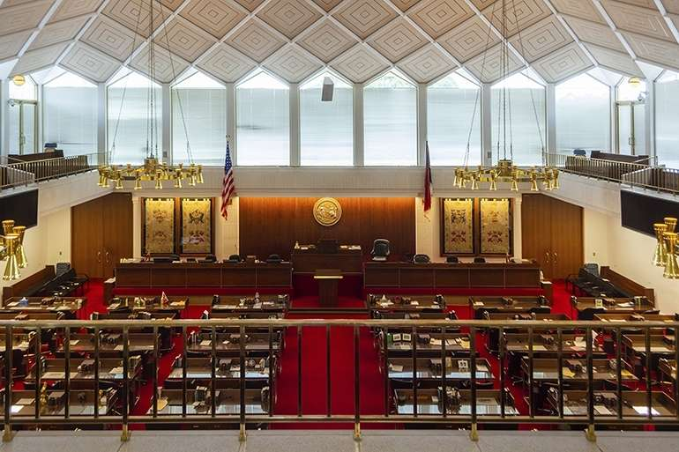
Session Law 2023
Moved responsibility for all child fatality reviews to the Department of Public Health and a new Office of Child Fatality Prevention
Combined Community Child Protection Teams (CCPT) and Community Fatality Prevention Teams (CFPT) into one Local Team to review all child fatalities including maltreatment fatalities
Discontinued the process within NCDHHS DSS for Intensive Child Fatality Reviews
Required NCDHHS DSS to create Citizen Review Panels to meet CAPTA requirements
This Photo by Unknown Author is licensed under CC BY-NC
Notes:
Citizen Review Panels have been outsourced to HMA; 3 regional teams

Slide 11
As of June 30, 2025, NCDHHS DSS resolved all outstanding Intensive Child Fatality Reviews by conducting a combination of in person reviews and case record desk reviews.
NCDHHS DSS worked with the new Office of Child Fatality Prevention(OCFP) to develop working processes and an MOU for collaboration for data sharing.
NCDHHS DSS continued to work on the Child Welfare Fatality Information System (CWFIS) being built to streamline notifications of child fatalities by State and County users as the system is connected to PATH NC.
Notes:
Reference the DCDL (CWS-04-2025) that was sent out regarding tiered reviews

Slide 12
Transition Process
January 2025 the CWFIS system went live for Child Fatality Consultants.
Counties are still required to make notifications via email or e-fax on the DSS-5009.
Child Fatality Consultants manually enter the written notification into CWFIS.
CWFIS was integrated into PATH NC in August of 2025 and only live to Child Fatality Consultants.
Planned go-live for County users is tentatively scheduled in late Spring of 2026.
Does not impact PATH NC Ongoing roll out.

Slide 13

Addressing Immediate Safety
When NCDHHS DSS receives a Near Fatality or Fatality notification from a local county child welfare agency and there are surviving children, it is referred to the assigned RCWS to ensure all of the necessary information has been gathered.
The RCWS, Director, and RAMS (if applicable) will be notified if there are safety concerns identified in the notification that could impact current safety for the child and/or surviving children. The local county child welfare agency must respond to all unaddressed safety concerns identified without delay.

Slide 14

Current System Process
Office of Child Fatality Prevention (OFCP) (through the Local Teams) schedules all fatality review team meetings.
Required team members consist of county level DSS Director or designee and one additional DSS employee, among others.
RCWSs participate in the maltreatment fatality reviews as the child welfare policy expert for the team.
These reviews take place at least a year after the death of the child.

Slide 15

State Process
NCDHHS DSS
  receives the notification of the fatality from the local child welfare agency.
  Enters information into CWFIS
  Contacts the county for any additional information needed based on the completeness of the notification.
A two-party review of the information is screened for a Child Welfare Record Review.
Near Fatalities must also be reported per CAPTA requirements.
  Required to be entered and emailed or e-fax on the DSS-5009.

Slide 16
State Process continued
Child Welfare Record Reviews must be conducted in cases where there is a child fatality with concerns for suspected maltreatment AND:
  There is an open child welfare case, regardless of whether there are surviving children in the home.
  There is a child welfare case that was closed within the last year.
  There is a child welfare case that was screened out within the last year.
  Media attention requires a NCDHHS DSS response.
  There is a specific request by a legislator.
  NCDHHS leadership identifies that based on the information a review is warranted.

Slide 17
Cases warranting an Immediate Review:
Immediate cases will result in a Child Welfare Record Review. The Child Fatality Consultant will notify the Director when the case requires an Immediate Child Welfare Record Review. The local county child welfare agency has 3 business days from the receipt of the email to upload all child welfare records for review.
These reviews will be completed and available for NCDSS leadership review within 7 days of the receipt of the records.

Slide 18
Fatality Policy
Review Process | Closed Case | Open Case | Immediate
Fatality Notification | Within 2 business days (via email) | Within 2 business days (via email) | Within 2 business days (via email)
Case Review Decision | Within 7 business days (via email) | Within 7 business days (via email) | As soon as identified (via phone)
Phone Contact with Director | Within 2 business days of the email | Within 2 business days of the email | As soon as identified (via phone)
Upload Child Welfare Record | Within 5 business days of email | Within 5 business days of email | Within 3 business days of email
Report Completion | Within 60 days | Within 30 days | Available to NCDHHS leadership within 7 days *Findings shared with Director

Slide 19

Near Fatality Policy
Notification
  Fatality Notification form
  Within 2 business days of county awareness
  Screen all reports of child Near Fatality
  RCWS (within 1 business day)

Slide 20

Intake Policy-Child Born to open 109

Slide 21
Intake Policy Changes
When a child is born to a parent with an open Foster Care case, prior to Termination or relinquishment of their parental rights, a new report must be made to assess the safety of a new born in a household where other children have been removed.
Legal Basis: G.S. 7B-101 (15)
  In determining whether a juvenile is a neglected juvenile, it is relevant whether that juvenile lives in a home where another juvenile has died as a result of suspected abuse or neglect or lives in a home where another juvenile has been subjected to abuse or neglect by an adult who regularly lives in the home.

Slide 22
Intake Policy Changes continued…
Will be assessed as a Family Assessment, Neglect—Injurious Environment.
Additional guidance around:
  Screening for other possible maltreatment concerns
  Response time based on current circumstances of the open 109/Permanency Planning case
  Collaboration with Permanency Planning case worker

Slide 23

Discussion/Questions?

