Slide 1

More Than A Job NC (Formerly FNS E&T)
All the way to 100 Partner Presentation

Slide 2






Staff Introductions

Slide 3
Purpose Statement
More Than A Job NC empowers individuals to reach their career potential and meets the workforce needs of North Carolina by enabling our trusted partners to provide jobs-driven, skills-based training, education, and support services that improve the confidence, health, and well-being of participants, families, and communities.

Slide 4
Program Timeline
1985
Congress established SNAP E&T to assist SNAP recipients in gaining skills, training, work, or experience that would increase their ability to obtain regular employment
1996
North Carolina FNS E&T began operations
2009
North Carolina ended mandatory E&T
2017
Program consisted of 6 providers
2023
Program footprint of 15 providers across 15 counties
2024
Expansion of program coverage to 29 counties; addition of virtual providers
2025
Program has expanded to 58 Counties, 3 intermediaries, 48 Partners
2026
Program expanded to 75 counties, 3 intermediaries, 52 Partners

Slide 5
Participant Eligibility
To participate in More Than A Job NC, an individual must:
Be an FNS beneficiary
Be at least 16 years of age
Be a resident of a county More Than A Job NC operates in
Be able to work upon program completion
Have the physical and mental ability to work at least 20 hours per week
NOT be a beneficiary of Work First Family Assistance (WFFA) required to participate in employment services. FNS beneficiaries who are a part of WFFA Child-Only cases may receive More Than A Job NC services
NOT be a refugee subject to work requirements imposed by a Refugee Resettlement Program (RRP)

Slide 6
Services Offered
Case Management: Comprehensive intake assessments, individual employment plans, progress monitoring, or coordination with service providers
Education: Programs like English as a Second Language or Adult Basic Education courses
Skills Training: Training in a skill or trade to improve employability in areas like culinary arts, technology, construction, healthcare, hospitality, retail, manufacturing and more
Job Search Training: Instruction in job-seeking techniques, motivation, and self-confidence
Supervised Job Search: Requires participants to make a predetermined number of inquiries to prospective employers
Self-employment: Participants receive technical assistance in developing business plans and in creating financial marketing plans, and learn how to access business grants
Work experience: May include either a work activity or a work-based learning program
Support Services: Includes transportation, testing fees, child care, books and training materials, uniforms, and personal safety items
Job Retention: Support services for individuals who secured employment (up to 90 days)

Slide 7
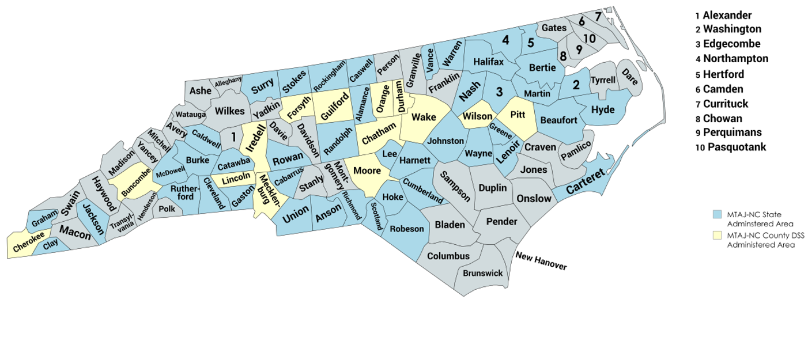
Program Administration
MTAJ-NC functions in a hybrid state-supervised, and state and county-administered format.
Notes:
We have been hard at work expanding the coverage area of MTAJ-NC, growing from 15 counties in FY 23, to 29 counties in FY 24, to now 58 counties in FY 25. We are continuing to work at expanding both the breadth of coverage area and depth of services the program provides in each county, which is where you come in as a potential partner!

Slide 8
















Current Partner Providers

Slide 9












Current Partner Providers

Slide 10
Role of Partner
Direct Support for Participants: Providers deliver key services such as employability assessments, personalized employment plans, training, and support.
Purpose: Connect participants to your organization to help them overcome employment barriers and achieve lasting success.
Benefits of Partnership:
Maximize Resources - Utilize existing funds to better serve FNS beneficiaries.
Flexible Funding - Cover various allowable costs and expand service types.
Increase Capacity - Serve more individuals and broaden available services.
New Funding Stream - Access funds for participant support, with a 50% reimbursement rate.
Our Network: Collaborations with community-based organizations, colleges, and training providers create pathways for sustainable employment.
Notes:
As providers, your direct support is crucial for empowering participants. You help deliver essential services such as employability assessments, personalized employment plans, and comprehensive training and support services. By partnering with More Than A Job NC, you become a bridge for participants, helping them overcome barriers and navigate their path to employment success.
Why is this partnership important? Many FNS beneficiaries face challenges entering today’s competitive job market due to skill gaps. This is where your expertise and support come in. Through your services, participants gain access to the resources and training they need to secure sustainable employment and educational opportunities.
Our network thrives on partnerships with community-based organizations, community colleges, and training providers like yours.
Provider Reimbursement: As a provider, partnering with us means you could be eligible for up to 50% reimbursement of allowable costs when non-federal funds from your organization are used to pay for a participant's participation. Your services contribute to giving someone the tools to live a more fulfilling life and if you are an employer, your organization could be reimbursed for training individuals who might become your future employees.

Slide 11
Program Administration
Form used to enroll MTAJ-NC participants:
Screening and Referral
Assessment
Individual Employment Plan
Forms provider and county staff must complete:
NC Works Training Sign Off form
Confidentiality form
Participant FNS data is stored in NC FAST
Participant MTAJ-NC data is stored in NC Works

Slide 12

Participant Experience
“Love the Experience. This program was very helpful. I really thank them for everything”
“I love this program!”
“This program is a blessing to any individual looking for opportunities to get on their feet”

Slide 13
Data on Success of Program
We believe in the power of partnership to amplify our impact!
Participants Served by Year
2020: 1227
2022: 1750
2023: 1915
2024: 2418
Gender Ratio
2020: 73% Female; 27% Male
2024: 60% Female; 40% Male
Employed after year
2020: 8%
2022: 44%
2023: 63%
2024: 64%
Notes:
Do we want to add English as Second Language Stats? Or Top Certifications earned with MTAJ-NC?

Slide 14
MTAJ-NC Goals
Measurable Skills Gains in NC Works
Percentage of Job Retention, entered Workforce
Median Income
$5,200/3=$1,733.33 Monthly
Median Income Goal: $6,000= $2,000 monthly
Onboarding local DSS(CM&EPIE)

Slide 15
Partner Onboarding
North Carolina develops the More Than A Job NC State Plan for approval by USDA-FNS annually by August 15th. Each partnering county is required to provide a Plan of Action (POA) to the State office annually each Spring and each Provider is required to submit an updated contract annually each Spring.
Annual Forms
Plan Of Action/Scope of Work
Budget
We encourage utilizing the following until the application period:
Monthly Office Hours
More Than A Job NC Quarterly Meetings
Provider Resources on our website/Sharepoint

Slide 16
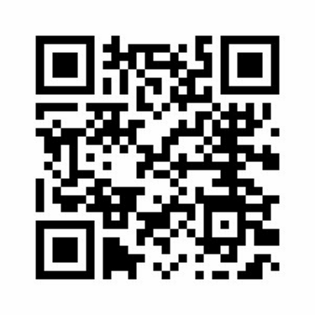
Questions?
Website: www.ncdhhs.gov/morethanajobnc
Operations Support Line: 919-707-5617
Email: mtaj-nc@dhhs.nc.gov

