Slide 1


WORKSHOP INFORMATION INSIDE!
2026 SSI
SPONSOR OPPORTUNITIES

Slide 2
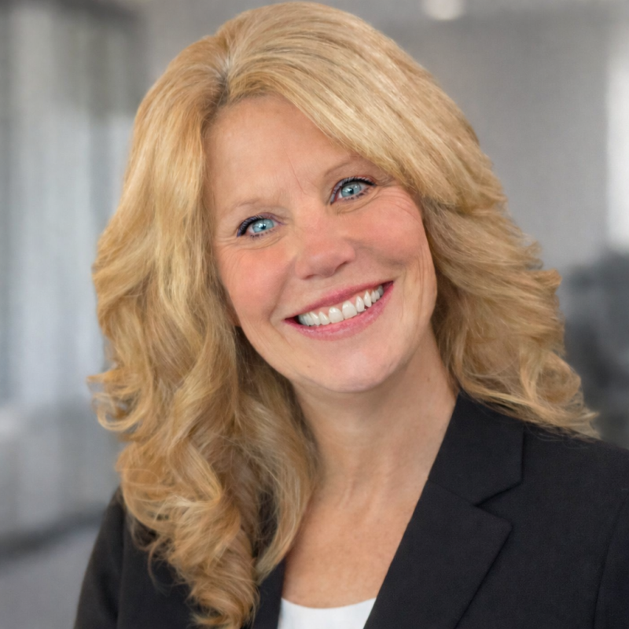
As the new NCACDSS Executive Director, I am honored and excited to step into this role as we embrace this year’s Social Services Institute theme, “Empowering Connections.”
It is truly an honor to join this inspiring community—one that has spent more than a century strengthening North Carolina through collaboration, compassion, and bold, innovative ideas.
Please join me in a heartfelt thank you to Sharnese Ransome for her many years of dedicated service. Her leadership has shaped so much of who we are today, and I’m humbled to follow in the path she helped pave. Looking ahead, I’m energized by the opportunities before us.
In these times, we have the chance to deepen our connections—across communities, across teams, and through evolving technologies that help us reach people in new and meaningful ways. With your sponsorship, we accelerate that impact and empower North Carolina residents with the support, creativity, and innovation they deserve.
Together, we’re not just continuing the work—we’re expanding it,
strengthening it, and building something
extraordinary for the future.
Karen
Karen Powell, NCACDSS Executive Director

Slide 3


SSI 2026 SPONSORSHIP BENEFITS
Workshop Opportunities
Registration Welcome Message
Ballroom Ad Space
On-stage Greeting to Attendees
Email Marketing to Directors
Registrations and Luncheons for Booth Staff
Your Logo on all SSI Promotional Materials
…AND MORE!

Slide 4


LEGACY DIAMOND PLUS SPONSOR
25+ years of sponsorship
The SSI Committee gratefully acknowledges Myra Powell and her team at Vanguard Professional Staffing for their ongoing sponsorship of the SSI Innovative Awards Luncheon.

Slide 5

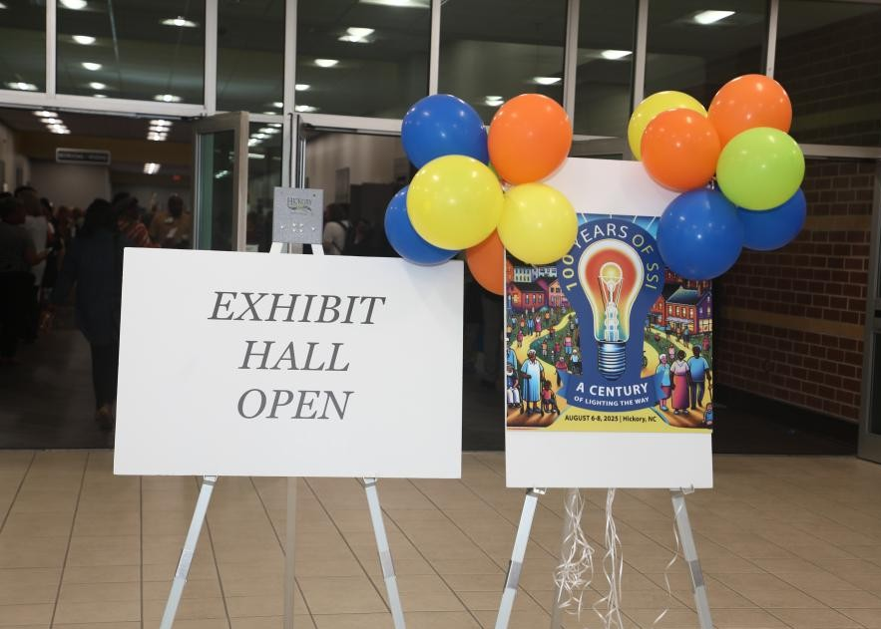
DIAMOND PLUS Sponsor $9,200
Lanyard sponsor
Directors’ / DSS Board Leadership Meetup sponsor
DSS Director’s Breakfast sponsor
Workshop opportunity
Prime booth location
Email marketing to directors
On-stage greeting to attendees
4 registrations and lunches
DIAMOND Sponsor $8,200
Directors’ / DSS Board Leadership Meetup sponsor
DSS Director’s Breakfast sponsor
Workshop opportunity
Prime booth location
Email marketing to directors
On-stage greeting to attendees
3 registrations and lunches

Slide 6

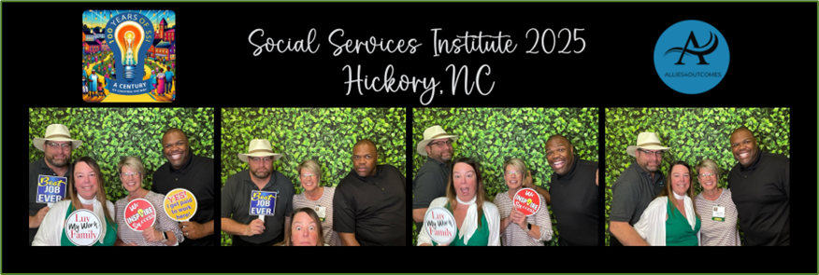



PLATINUM Sponsor $7,700
DSS Board Breakfast and County Longevity Awards sponsor
Workshop opportunity
Prime booth location
Email marketing to Directors
On-stage greeting to attendees
3 registrations and lunches
PHOTO BOOTH Sponsor $7,000
Sponsorship of 3 hours of fun at one of the two photo booths, with your logo on the prints
Prime booth location
Email marketing to Directors
Workshop opportunity
3 registrations and lunches

Slide 7
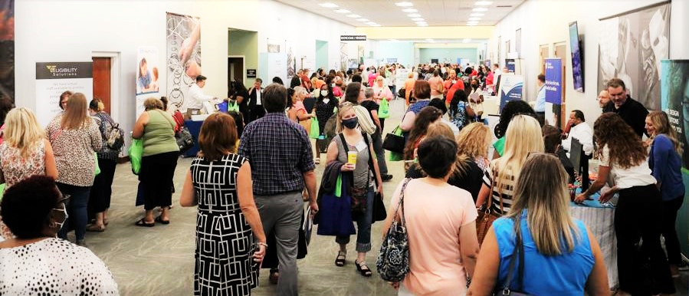

GOLD Sponsor $5,700
Conference networking sponsor
Opening session sponsor
Prime booth location
Email marketing to directors
On-stage greeting to attendees
2 registrations and lunches
SILVER Sponsor $4,700
Closing session sponsor
Prime booth location
Email marketing to directors
On-stage greeting to attendees
2 registrations and lunches

Slide 8
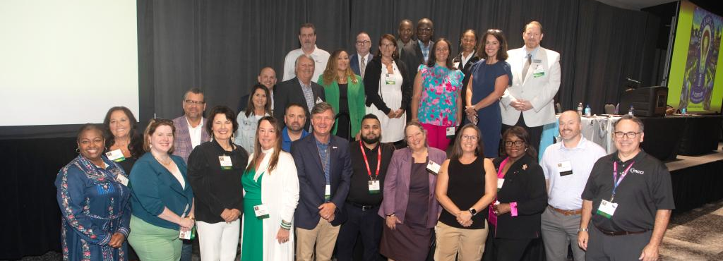

GAME ROOM Sponsor $4,000
Pre-conference networking sponsor
Email marketing to directors
On-stage greeting to attendees
Prime booth location
2 registrations and lunches
BRONZE Sponsor $3,200
Break sponsor
On-stage greeting to attendees
2 registrations and lunches
GENERAL Sponsor $2,000
Friends of Volunteers sponsor
On-stage greeting to attendees
2 registrations and lunches
*note no exhibit booth is included

Slide 9
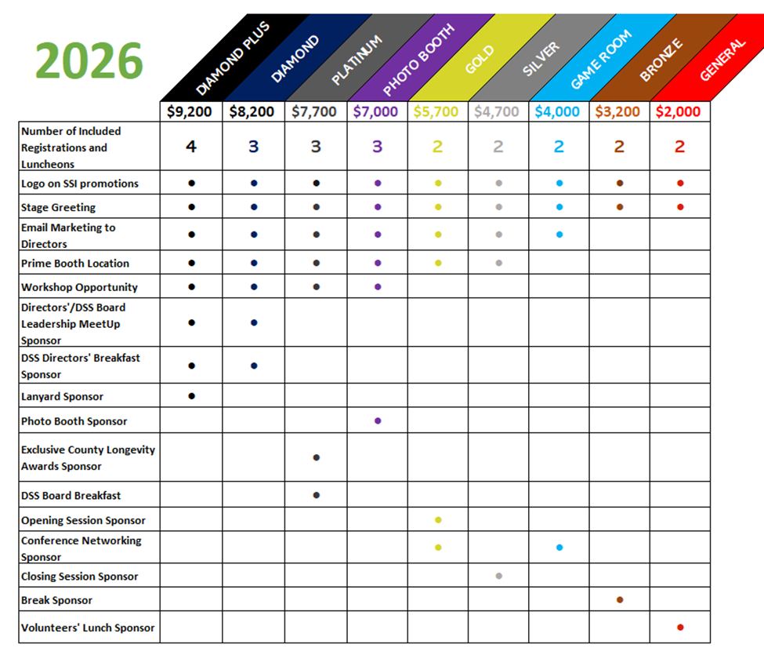
CLICK HERE TO SPONSOR SSI 2026!
ALL LEVELS INCLUDE:
Ballroom Ad Space
Digital Welcome Message at Registration
On-stage greeting
Your logo on all SSI promotions
Registrations and luncheons

Slide 10
As we continue our 2026 Social Services Institute planning, we ask our community partners to submit potential workshops they would like to conduct in person that align with this year’s theme.
Please submit a workshop proposal no later than May 22, 2026. You will be notified by June 15th if your workshop has been chosen for inclusion in SSI 2026.
Please plan to create a PowerPoint presentation to serve as a valuable resource for the county staff in attendance. PowerPoint presentations should be submitted to lbennett@ncacdss.org, no later than July 26, 2026.
Logistics for Workshops:
Please bring your laptop and cables to connect to the projector if you plan to use PowerPoint for your presentation.
Sound will be available if you have a video embedded in your presentation.
The rooms will be set up with a table across the front with four chairs. If additional chairs are available in the room as needed.
There will be four microphones in the larger rooms and two in the smaller rooms.

Slide 11


THANK YOU FOR YOUR SUPPORT!
We look forward to seeing you!
Questions?
Contact LaVerne Bennett at lbennett@ncacdss.org

