Slide 1
Elder Abuse
Notes:
Welcome and thank you for being a part of “Stop the Hurting”. A sensitive and hard subject, but important, that we address as individuals, congregations and church leaders. We have consulted and worked with NC Adult Protective Service leaders about Elder Abuse and Neglect. We want to be an open book and share what we have learned.

Slide 2
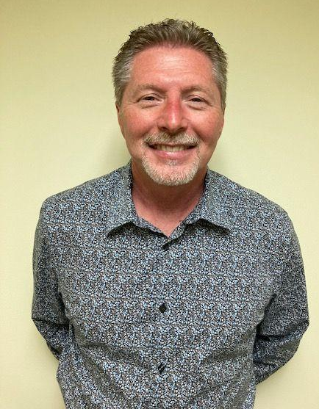
“Churches are able to do what Adult Protective Services cannot do!”
Rick Hall, Adult Services Division Director
Forsyth County Department of Social Services

Slide 3
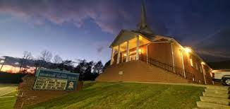
Role of the Church
“You play an important role as a “gatekeeper” for individuals who are abused, neglected or exploited in your community.”
Notes:
Ask the participants ……What role do you think the church could/should play??

Slide 4
CHURCH PROCESS
Raise Awareness
Identify
Action Prevention
Notes:
Staged approach
-Step 1 Raise awareness and provide resources
Educate self then congregation. Take this information, list of Abuse Indicators, resources and steps back to your church leaders and congregations.
-Step 2 Identify overall needs and existing resources- Identify gaps-
-Step 3 Take action to prevent. Call and report. Fill the gaps for missing resources to prevent abuse from occurring. For example- If there is no food services where individual lives church can provide meals

Slide 5
RAISE AWARENESS
Ask your church to add information about elder abuse to their newsletters and televised events.
Notes:
Elder abuse is not often discussed in congregations or communities, and that makes it hard to talk about. As a result, many older adults never get the help they need.
World Elder Abuse Awareness Day provides a great opportunity to break the silence, raise awareness, provide resources, and promote a better understanding of abuse and neglect of older persons.
Church can host meeting to raise awareness- NCBAM can provide the presentation. Also information can be placed in the church bulletins.

Slide 6
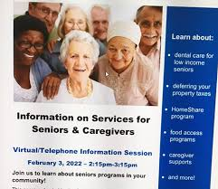
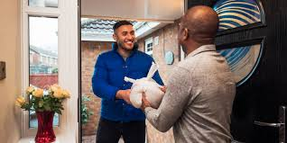
IDENTIFY NEEDS AND RESOURCES
Church members should know what help and services are already available in the community.
Identify overall needs and existing resources.
Identify gaps.
Notes:
Ask attendees; What are the overall needs of senior adults?
What resources are already available in your community to meet senior adult needs?
What are the gaps?
Church members helpful to know what help and services already available in your community
Identify overall needs and existing resources- Food banks, transportation, housing, adult services
Identify gaps-

Slide 7
ACTION
Raise Awareness
Make Reports
Minister to isolated or homebound including family/caregiver
Provide service to client after screened out
Respond to DSS request
Notes:
Raise Awareness
Make Reports
Minister to those in isolation or homebound and be sure to include the family and caregiver
Provide service to client after screened out
Respond to DSS request for for help with screen in cases.

Slide 8
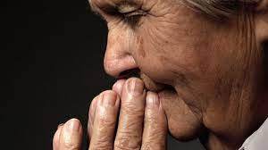
CHURCHES HAVE MORE POWER
What can churches do to stop the hurting?
Pray for God’s guidance. And move!
Visit the elderly in your community.
Listen with your ears, eyes and heart.
Give a caregiver a break!
Notes:
Pray for God’s guidance. And move!
Visit the elderly in your community.
Listen with your ears, eyes and heart.
Give a caregiver a break! Caregivers may become stretched to their limits. Provide respite, run an errand, help with the laundry, take dinner to them. May need time off, assistance locating resources, preventing isolation,
Visit those who live alone or in isolation. See what they need. Show them that God loves them, and that you do, too.

Slide 9
BARRIERS TO TAKING ACTION
Could create conflict within the church
Not wanting to get involved.
Notes:
Sensitive issues and private issues can create conflicts to arise. NCBAM can put you in touch with a pastor or other professional who is trained in conflict resolution.
Potential barriers
-Separation of church and state.
-church lacks leadership in outreach to most vulnerable
-Denial
-Lack of trust in the system
-Negative image
-fear of retaliation
-
Ask the participants what they think some of the barriers are. This will help us address the barriers.
(The presenter may want to go ahead and think of other barriers, just in case the participants do not).

Slide 10
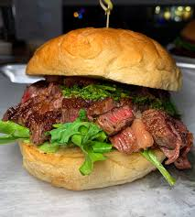
HELP SANDWICH
Bread - Church
Meat - DSS Adult Protective Services
Bread - Church
Notes:
If churches see a senior that may need assistance and they provide resources before going to DSS they can potentially avoid and prevent a crisis.
Rick Hall gave us this analogy of the Help Sandwich.
The Bread - The Church and congregation assist with local resources and does everything a church can. Church congregation may be first to recognize senior in need. Provide trips to Dr, pick up medicines or drop off food. Phone calls and visits to prevent isolation.
The Meat is DSS and they will evaluate and do what NC law and resources allow. APS, by law, is set up as an Intervention, not prevention.
The other slice of the Bread in the sandwich- after DSS evaluation the Church can assist with food, finances, housing, isolation, etc

Slide 11
THANK YOU!

Slide 12
CREDITS
Special thanks to all who assisted in this project:
LaVerne V. Blue, NCDHHS
Rick Hall, Forsyth APS
Roxann Sizemore, Buncombe APS Director
National Center on Elder Abuse (NCEA)
NC Dept of Human Health and Services (NCDHHS)
US Department of Justice

