Slide 1
Food and Nutrition Services
Cynthia Ervin
Jerquitta Hicks-Smallwood

Slide 2
SUN Bucks
USDA’s Newest Permanent
Food Assistance Program

Slide 3
SUN BUCKS Program Introduction
NC DHHS, in partnership with NC Department of Public Instruction (DPI), is expanding its food assistance efforts to become one of the first states to administer USDA’s new, permanent summer child nutrition program, Summer EBT which will be branded as “SUN Bucks”
NC DHHS will issue $120 per eligible child, which can be used to purchase nutritious food. Families known to be experiencing food insecurity with participation in certain programs are eligible to receive SUN Bucks benefits automatically, while others can apply.
A child automatically qualifies if they:
Attend a school that offers the National School Lunch Program and participate in free or reduced-price school meals.
Are between 7 and 16 years old and their household participates in NC FNS, Work First, or Medicaid.
A child should apply if they:
Attend a school that offers the National School Lunch Program, and their household income meets the requirements for free or reduced-price school meals.

Slide 4
Counties will play a pivotal role in the successful implementation of sun bucks
NC DHHS is spearheading the rollout of SUN Bucks for 2024, with counties in a supporting role. We ask that you familiarize yourself with the SUN Bucks program to support a successful statewide implementation this summer.
County Role in Summer 2024 SUN Bucks Administration
Next Steps
Inform customers about where they can find information about SUN Bucks (website coming soon!). Provide customer service as able using the tools made available and direct customers to the SUN Bucks Call Center as needed.
Receive communications from the EBT vendor (FIS) relating to undeliverable EBT cards.
Distribute SUN Bucks cards via local DSS office to eligible individuals who are foster care, or experiencing homelessness, did not have an address on file, did not include an address on their application or incorrect address. Note: These cards will be mailed to the local DSS offices.
Collaborate with NC DHHS to educate foster care workers on the program and encourage their involvement. Foster care workers will be responsible for ensuring the SUN Bucks card gets to the eligible child and goes with them in the event of caregiver fluctuation.
DSS County Directors to sign the required Data Confidentiality Agreement by March 15, 2024. If you have not completed and submitted the agreement, please do so before the 15th.
Visit the SUN Bucks | NCDHHS
Review USDA’s Summer Nutrition Programs website to learn more about the new program updates.
Keep an eye out for additional information from NC DHHS on key dates, FAQs, communications toolkit, and other important program details!

Slide 5
Interview Administrative Waiver
Ending May 31, 2024

Slide 6
NC administrative waiver – Interview- ends May 31, 2024
Effective June 1, 2024, NC will no longer have the administrative waiver that waives the eligibility interview if all mandatory verifications are completed
What does this mean
County Required Action
Interview requirements as cited in 7 C.F.R. 273.2(a)(2), 273.2(e), and 273.14(b)(3) requires an interview at initial application, expedited service, and recertifications. All households that submit a valid application, which includes a name, address,
and signature must be interviewed. Unless the household is interviewed on the same day they submit their application, an interview must be scheduled.
The interview is the most important step in the certification process for the Food and Nutrition Services (FNS). It is an opportunity to ensure the FNS applications are complete, to engage with applicants to fully understand their household circumstances, and to provide the assistance needed to understand their responsibilities in the certification process.
Explore and clarify the household’s circumstances and identify information that needs to be verified.
Screen the household for expedited service, work requirement exemptions, and student requirements.
Provide information to the applicant household regarding its rights and responsibilities under the FNS regulations and explain FNS program requirements.
Inform - interview requirement

Slide 7
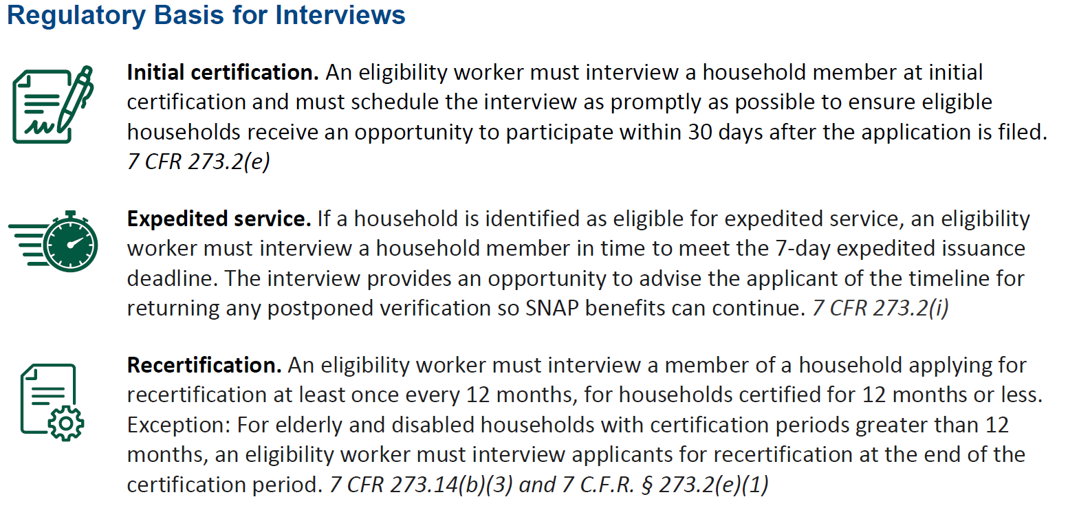

Slide 8
NC Payment Accuracy Error
Corrective Action Plan

Slide 9
NC Payment Accuracy Corrective Action Plan
NC DHHS needs each county’s help to reduce the Payment Accuracy Rate.
Find
County Required Action
Agency cause error-Wages/Salaries – root cause Misapplication of various aspects of policy including wages and salaries.
Client cause error- root cause- Client failed to report changes in their income.
Agency cause error – Retirement, Survivor's, and Disability Insurance (Social Security) - root cause-
Local Agency caseworkers failed to review IEVS computer matches while determining eligibility for applications and recertifications.
Client reported information was disregarded or not applied.
Agency failed to act on reported information and/or key in information clients reported on eligibility forms into the state eligibility system.
Local agency caseworkers misapplied policy when determining eligibility during applications, recertifications and change of circumstance
Document the case record when base period income is not budgeted
Show calculations
Address information reported on recertification forms, especially incomplete and/or conflicting information.
Review Online Verifications
Explain change reporting requirements to clients during the interview.
Attend the CQIS' Regional Quarterly meeting April 2024.

