Slide 1
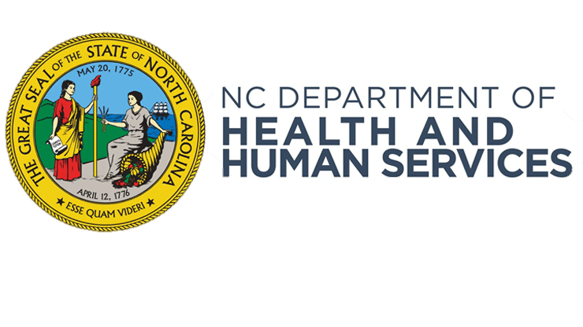
SUN Bucks
USDA’s Newest Permanent
Food Assistance Program

Slide 2
Food insecurity is a critical challenge in north Carolina
1 in 6
North Carolinian children
face hunger¹
56%
of NC students rely on free lunches at school²
12.8%
of people in NC live below the poverty line³
Causes of Food Insecurity
Impact to Children
Increased cost of living
Low income (households below the federal poverty line)
Lack of access to affordable supermarkets and grocery stores
Dependency on transportation
Reliance on schools to provide meals, limiting summer access to nutritious food and impacting children's health
Adverse childhood development outcomes, including heightened stress and worse academic performance⁴
¹ Hunger in North Carolina (Feeding America)
² Where in the US are Children Most Dependent on Free School Lunches (AAA State of Play)
³ Poverty Rate in NC (Statista)
⁴ Food Insecurity and Child Development: A State-of-the-Art Review (NIH)

Slide 3
Pandemic ebt (P-EBT) PROVIDED CRITICAL FOOD ASSISTANCE DURING THE SCHOOL YEAR, but the TEMPORARY program ENDED in 2023
Overview
North Carolina Department of Health and Human Services’ (NC DHHS) P-EBT program was a federally funded temporary food assistance program designed to provide benefits to purchase nutritious meals for students and young children during COVID-19. The program began in 2020 but ended in 2023.
Benefits
Like FNS EBT, benefits were provided on a debit-like card to buy food at authorized EBT retailers, including most grocery stores.
Statewide Impact*
1.76 million students & young children served
$2.5 billion issues in benefits
93% spend rate, indicating a critical need for assistance
*All figures are approximate and rounded

Slide 4
SUN BUCKS Program Introduction
NC DHHS, in partnership with NC Department of Public Instruction (DPI), is expanding its food assistance efforts to become one of the first states to administer USDA’s new, permanent summer child nutrition program, Summer EBT which will be branded as “SUN Bucks.”
NC DHHS will issue $120 per eligible child, which can be used to purchase nutritious food. Families known to be experiencing food insecurity with participation in certain programs are eligible to receive SUN Bucks benefits automatically, while others can apply.
A child automatically qualifies if they:
Attend a school that offers the National School Lunch Program and participate in free or reduced-price school meals.
Are between 7 and 16 years old and their household participates in NC FNS, TANF, or Medicaid.
A child should apply if they:
Attend a school that offers the National School Lunch Program and their household income meets the requirements for free or reduced-price school meals.

Slide 5
SUN BUCKS 2024 PROGRAM GOAL and impact
NC DHHS and NC DPI aim to combat food insecurity experienced by NC’s youngest, most vulnerable residents.
1 million*
NC children will receive benefits to increase access to healthy food choices during the summer months.
$120 million*
in food assistance benefits during the 2024 summer months, feeding children while boosting NC’s economy.
*Approximate, rounded figures.

Slide 6
Sun bucks will address existing accessibility gaps in food assistance programs
SUN Bucks will transform North Carolina’s summer food assistance strategy into a three-pronged approach that emphasizes accessibility.
Currently, North Carolina operates two federally-funded summer meal programs: the Non-Congregate Meal Service and Group Meal Service. Accessibility challenges associated with these programs that SUN Bucks will directly address include:
Coming Soon:
SUN Bucks
Group Meal Service
Non-Congregate Meal Service
Children in need may live in districts that do not meet Group Meal Service income requirements.¹
Locating rural sponsors can be challenging due to logistics for food transportation.¹
89% of Group Meal Service sites require transportation to access, but only 30% of sites provide transportation.²
¹ Challenges in serving rural American children through the Summer Food Service Program (unh.edu)
² Summer Meals Study. Summary. (azureedge.us)

Slide 7
SUN Bucks is an Evidence-based Program, SUPPORTED BY A successful 3-Year pilot
Over a three-year period, USDA implemented a successful pilot program to provide electronic benefits in specific states & ITOs to test its effectiveness.
An evaluation assessment ¹ of the pilot found:
33%
decrease in “very low” food insecurity in children
89%
of participants redeemed their issued benefits
Increase in households’ food expenditures
Improved dietary quality for most of the nutrition outcomes surveyed
Increased whole grain, dairy, vegetable & fruit consumption
Decreased sugar-sweetened beverages consumption
¹ Summer EBT — A Tested and Effective Strategy for Ending Summer Hunger | Food and Nutrition Service (usda.gov)

Slide 8
Counties will play a pivotal role in the successful implementation of sun bucks
NC DHHS is spearheading the rollout of SUN Bucks for 2024, with counties in a supporting role. We ask that you to familiarize yourself with the SUN Bucks program to support a successful statewide implementation this summer.
County Role in Summer 2024 SUN Bucks Administration
Next Steps
Inform customers about where they can find information about SUN Bucks (website coming soon!). Provide customer service as able using the tools made available and direct customers to the SUN Bucks Call Center as needed.
Receive communications from the EBT vendor (FIS) relating to undeliverable EBT cards.
Distribute SUN Bucks cards via local DSS office to eligible individuals who are experiencing homelessness, did not have an address on file, or did not include an address on their application. Note: NC DHHS will mail these cards to the local DSS offices.
Collaborate with NC DHHS to educate foster care workers on the program and encourage their involvement. Foster care workers will be responsible for ensuring the SUN Bucks card gets to the eligible child and goes with them in the event of caregiver fluctuation.
DSS County Directors to sign the required Data Confidentiality Agreement by March 31, 2024. More information coming soon.
Review USDA’s Summer Nutrition Programs website to learn more about the new program updates.
Keep an eye out for additional information from NC DHHS on key dates, FAQs, communications toolkit, and other important program details!

Slide 9
Eligibility overview
Source: USDA Webinar

Slide 10
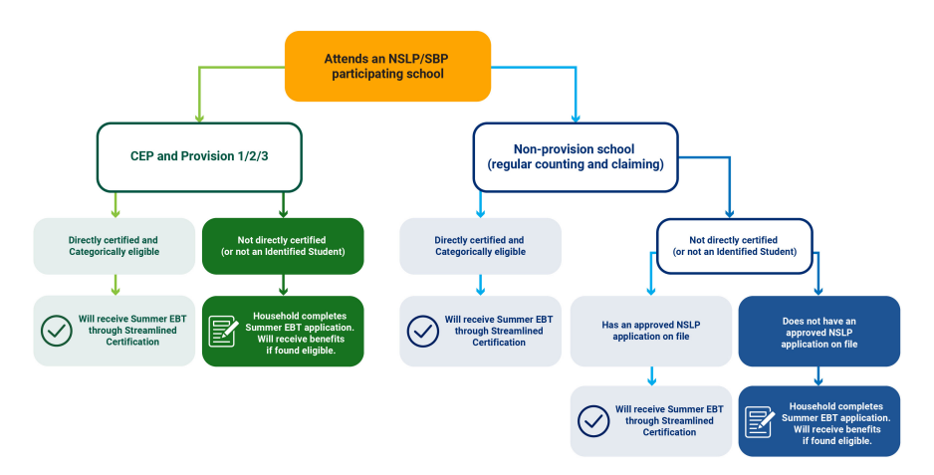
Eligibility for nslp/sbp students
Eligibility flow for children who are enrolled in NSLP/SBP participating schools
Source: USDA Webinar

Slide 11
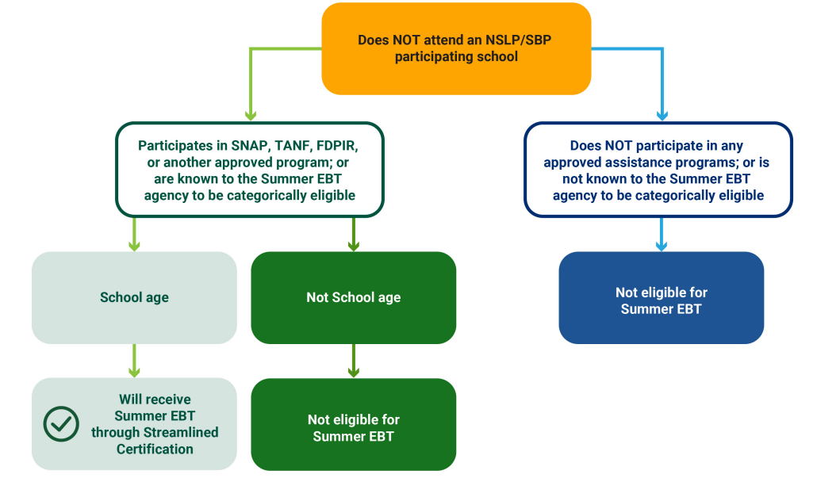
Eligibility for non-nslp/sbp students – Ages 7-16
Eligibility flow for children who are not enrolled in NSLP/SBP participating schools
Source: USDA Webinar

