Slide 1
THE FIRST 30
Building Better Systems.
Creating Greater Impact.
PRESENTED BY:
CARTERET COUNTY DSS

Slide 2





TOPICS OVERVIEW
WHY
WHAT
IMPACT
HOW

Slide 3
CARTERET
COUNTY
DSS
WHY
How did we recognize the need to do more to engage and empower the families we serve?

Slide 4
WHY
The First 30
Our hope is to increase partnership between:
The transferring and receiving teams (SWS+SW)
Increase understanding of the case;
Create space for open communication;
Demonstrate shared responsibility;
Eliminate the “ball was dropped” mentality.
The receiving SWS and SW
Increase clarity of message;
Create a supportive culture.
The Department and the Family
Cultivates relationship and connection;
Improves communication;
Establishes a strong foundation + trust from the start;
Increased collaboration with family centered practice.

Slide 5
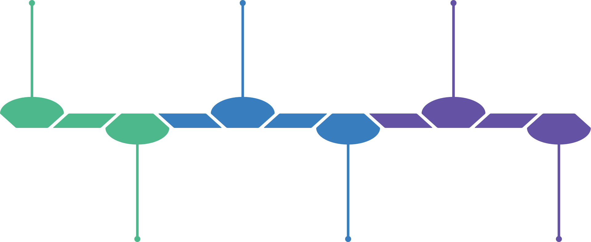
THE FIRST 30 OVERVIEW
TRANSFER CONFERENCE
PREP + PLANNING FOR EXPLORATION
FSA FINALIZED W/IN 30 DAYS AT CFT
A process of building
CASE ASSIGNMENT + REVIEW
INTRODUCTORY HOME VISIT W/IN 7 DAYS*
EXPLORATION VISITS + JOINT DEVELOPMENT OF FSA

Slide 6
IMPACT
What our staff share about this practice..
“Allows for collaboration.”
“Feel supported by SWS.”
“Better understanding of where to go.”
“Takes more time, but it’s worth it.”
“Family less overwhelmed.”
“Able to gain valuable insight with open conversation.”
“Feel more prepared to work with the family.”
“Sense of clarity.”
“Family more engaged.”
“More digestible for family.”

Slide 7
CARTERET
COUNTY
DSS
Implementation Strategies + Challenges
Creating buy-in from our supervisory team
Generating excitement from our front-line staff (assessment, in-home, and permanency planning teams)
Anticipating + planning for potential barriers (i.e. TIME) and our response to these
Roll out of training + best strategies for our team in this
Implementation: we listened, we reflected on tough feedback, we adjusted
Staff turnover + changes= REIMPLEMENTATION
CQI + Training as PARTNER in Child Welfare practice
CQI as a CONTINUOUS quality improvement effort
The importance of follow up and feedback

Slide 8




THE FIRST 30
WHAT IS ONE TAKEAWAY?
WHAT ARE YOU MOTIVATED TO DO?
WHAT CAN YOU DO?
WHAT CAN YOUR AGENCY DO?

Slide 9
THANK YOU
Questions?
Contact Information:
Kelly Dorman, Organizational Development + Training Manager * kelly.dorman@carteretcountync.gov
Kody Krebs, JD|MSW, Assistant Director * kody.krebs@carteretcountync.gov

