Slide 1
NC Department of Health and Human Services
Division of Social Services
Children Services Committee
Lisa Cauley, Senior Director of Child, Family & Adult Services
Teresa Strom, Section Chief for County Operations
February 9, 2022

Slide 2
Child Welfare Services January 2022
Lisa Cauley
Senior Director
Child, Family, and Adult Services
Lechelle Evans
Executive Administrative Support
Vacant
FFPSA Manager
Deputy Director of Practice
Vacant
Deputy Director of Operations
Sarah Lewis-Peel
Child Welfare Communication Manager

Slide 3
Child Welfare Services
Vacant
Deputy Director of Practice
Vacant
Deputy Director of Operations
Kathy Stone
Chief of Safety &
Prevention
Carla McNeill
Chief of Permanency
Teresa Strom
Chief of County Operations
Linda Waite
Chief of Regulatory & Licensing

Slide 4
Child Welfare Section
Deputy Director
Practice
Deputy Director
Operations
Chief of Safety &
Prevention
Child Protective Services
Intake
Assessments
In Home
Community Based Child Protection Team
Child Fatality Reviews
Chief of Permanency
Foster Care Services
Transition Aged Youth Services
Adoption & Kinship Care Services
ICPC
Chief of County Operations
Constituent Concerns
CQI
Quality Assurance
(CFSR case reviews)
Training and Work Force Development
Chief of Regulatory & Licensing
Licensure of Foster Homes and Residential Child Care Facilities
Oversight of private foster and adoption agencies
IV-E Coordination

Slide 5
Child Welfare Services
CFSR Round 4
Teresa Strom, Section Chief for County Operations

Slide 6
Child and Family Services Review (CFSR) Overview
Children’s Bureau monitors state child welfare programs by assessing states for substantial conformity with federal requirements for child welfare services
There have been 3 Rounds of CFSRs with the 4th round beginning this year and NC will enter Round 4 in 2023
With the ultimate goal of improved child welfare programs for children and families, 7 outcomes and 7 systemic factors are reviewed
SOURCE: Children’s Bureau Child and Family Services Reviews “Fact Sheet”
Notes:
Bullet 1: The child and family services review (CFSR) is the federal review of a state’s child welfare program. It looks at compliance with federal requirements, what children and families are actually experiencing, and identifies areas for continuous quality improvement in child welfare programs.
Bullet 2: There have been 3 CFSR reviews conducted, known as Rounds. North Carolina completed Round 3 completely in 2020. Through a Program Improvement Plan (PIP) North Carolina completed various strategies and saw improvement in all areas except in achieving timely permanence.

Slide 7
Child and Family Services Review (CFSR)
7 Outcomes
Safety
Children are first and foremost, protected from abuse and neglect
Children are safely maintained in their homes whenever possible and appropriate
Permanency
Children have permanency and stability in their living situations
The continuity of family relationships and connections is preserved for families

Slide 8
Child and Family Services Review (CFSR) Outcomes (continued)
Family and Child Well-Being
Families have enhanced capacity to provide for their children’s needs
Children receive appropriate services to meet their educational needs
Children receive adequate services to meet their physical and mental health needs

Slide 9
Child and Family Services Review (CFSR) Systemic Factors
7 Systemic Factors: (effectiveness of)
Statewide child welfare information system
Case review system
Quality assurance system
Staff and provider training
Service array and resource development
Agency’s responsiveness to community
Foster and Adoptive Parent licensing, recruitment and retention

Slide 10
Components of the CFSR
Two-Stage Process
Statewide Assessment
The statewide assessment is the state’s evaluation of its performance on CFSR outcomes and systemic factors and is used to guide the focus of the onsite review
A change in Round 4 builds the framework of the assessment to include a wide range of interviews with community stakeholders (courts, community agencies, service providers, foster families, caseworkers, persons with lived experience, etc.)
Onsite Review
Case reviews
Interviews with children and families engaged in services
States not achieving substantial conformity must develop and implement PIPs addressing areas of nonconformity

Slide 11
CFSR and NC’s Lessons Learned from Round 3
Engage stakeholders early and often
Solely utilize state reviewers
Share data frequently
Expand protocol manual
Develop metrics to evaluate interventions

Slide 12
NC’s Preparation for CFSR Round 4
North Carolina has already developed a core team assigned to preparing our state
NC is participating in monthly Round 4 technical assistance calls conducted by ACF to inform the process
NC is reviewing the Statewide Assessment that must be done and identifying stakeholders
NC has continued to conduct OSRI reviews and is refining these to align with the State’s CQI planning
NC is utilizing a regional approach in conducting OSRI reviews that is hoped to continue into Round 4

Slide 13
Conflict of Interest (COI)
Jurisdiction
Assists

Slide 14
COI – What is it?
Agency (child welfare agency) employees
A caretaker in a sole-source contract group home
County Commissioner
County Manager
Foster parent supervised by the county
Governance structure
Members of the Board of Directors and/or Board of Social Services
Relatives of agency employees
Child’s parent/caretaker who is an incompetent adult and who is a ward of that child welfare agency
Minor in foster care who is also a parent/caretaker
COI exists when the county agency director perceives within their professional judgment as having a COI
Notes:
Rule 70E

Slide 15
Intake/Screening
Immediate safety concerns should be screened and initiated by the resident county.
Reports identified to be a COI without an immediate safety concern are immediately referred to a partner county who will screen the report within 2 hours of receipt.
Screening decisions stand regardless of which agency screens the report.
The agency making the screening decision sends reporter notice within 5 business days.
New reports received during open services will be screened and completed by the partner county.

Slide 16
Assessment
All COI assessments will be given the same priority as any assessment conducted by the partner agency.
If there are immediate safety concerns and the resident county initiates the case, it is the responsibility of the resident county to staff and provide documentation within 72 hours of all of the information gathered to the partner county.
The partner county should update the resident county at 45 days as to the status of the case decision and the partner county has the final responsibility for determining this decision.
The agency conducting the assessment will not change until a case decision is made, even if the family moves during the assessment.
The partner county is responsible for providing all documentation to the resident county within 72 hours of case decision.

Slide 17
In-Home Services
Once a case decision is made to transfer to CPS In-Home Services, the need for ongoing assistance by a partner county should be reviewed.
If the COI continues, the partner county will maintain responsibility for the In-Home Services case.
If a COI arises during the provision of In-Home Services, the resident county will not retain the case and the partner county will respond to the COI request within 24 hours.
If there is court involvement in an open In-Home case and a COI arises, a motion to review in juvenile court must be filed.
The partner county will supply documentation to the resident county no later than 72 hours after completion of case closure.

Slide 18
Permanency Planning
All reports involving a child in the custody of a county shall be referred to a partner county for assessment unless the allegation is on the removal home.
A Memorandum of Agreement or Inter-County Agreement may be utilized to address funding issues.
The partner county will determine IV-E eligibility.
The partner county will claim reimbursement for state and federal shares
Notes:
This is the Division’s stance about the discrepancy between the Conflict of Interest section and the Jurisdiction section. It is not a conflict for the agency to work the case unless the director deems it a conflict.

Slide 19
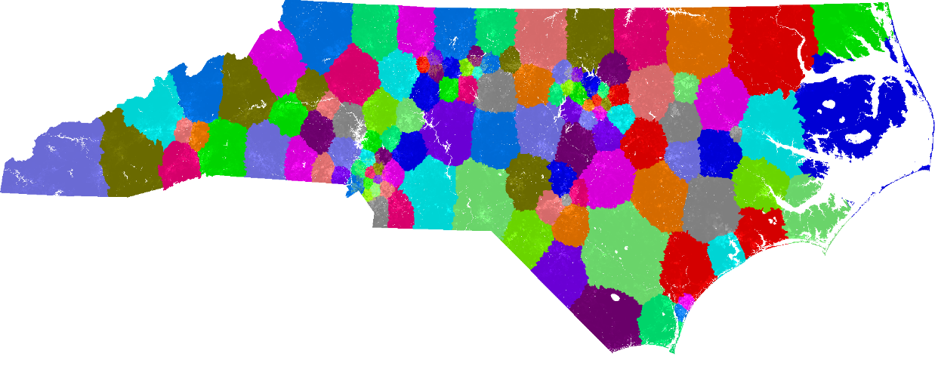
Jurisdiction
All 100 counties bear the responsibility for ensuring the safety and well-being of all children and their families.
The county of residence is the primary county responsible for the delivery of services to a family. (NCGS § 153A-257)
The Division is responsible for determining which county shall provide child welfare services when two or more counties cannot agree.

Slide 20
“Resides”
Where the child:
Receives public assistance
Is enrolled in school or childcare
Works
Receives mail
The location listed on the child’s medical records, driver’s license or library card.
The child resides in the place where he/she sleeps most often, lives, has the greatest number of daily contacts, unless the child is in foster care placement, a hospital or other remedial facility.

Slide 21
“Resides”….. the sequel!
If a family is living in a Homeless or DV shelter, the child Resides if the following are true:
Parents states he/she intends to make the county his/her permanent address
Has a job in the county the shelter is located
Has a child in school in the county where the shelter is located

Slide 22
Staffing County to County
When possible, face to face meetings should occur when discussing case decisions and case plans by all county child welfare agencies involved.
When a partner agency completes a CPS Assessment for the resident county agency, and the decision is to open 215 services in the resident county, the assessment worker from the partner agency should make a visit with the resident agency to explain the case decision.

Slide 23
CPS Assessments
When custody of the child is jointly held between parents who reside in different counties, and none of the above items determine the county of residence, consider the residence of the mother first, and then the residence of the father in accordance with NCGS§153A-257.
If child doesn’t live with either parent, the county responsible for the assessment is the county where the child is found.
A temporary safety provider is to be considered a voluntary temporary arrangement and is not legally secure. It should not be considered a change in residence.

Slide 24
Request for Assist
Must be verbal, with acknowledgement of receipt of the request by the assisting county.
Include sharing of the DSS-1402, Central Registry check and any other information gathered during the intake process to the assisting county by fax or secure e-mail.
Include sharing of the completed documentation of pertinent information gathered during the CPS Assessment to the assisting county by fax
If the resident agency decides or desires to make a contact or complete an activity in another county; permission from the partner agency should be obtained to enter into the partner county.
Notes:
DON”T LEAVE A VOICE MAIL OR SEND AN EMAIL. TALK TO A HUMAN BEING!!

Slide 25
When Counties Disagree
At no time should a report of child maltreatment be allowed to go unassessed due to a disagreement between counties or the inability to get a county to assist.
Counties should develop MOU’s as well as case specific MOA’s to prevent disagreements.
In the event that two county child welfare agencies cannot resolve an issue and the issue has been addressed through the levels of management up to and including the Director, then either agency can contact its Regional Child Welfare Consultant for guidance.

Slide 26
The of the Matter
When the delivery of child welfare services involves multiple counties, it is expected that each county child welfare agency work in a collaborative and coordinated manner in order to provide greater continuity of services to families while providing stability and ensuring safety for children.
They are all North Carolina children.
Notes:
Emphasize the highlighted

