Slide 1
CQI Process/Review Tools
Teresa Strom
Section Chief, County Ops

Slide 2
Regional Child Welfare Consultants
Each month the RCWC prepares to meet with the county
Identify the records to review and provide list to county a week in advance
Send consult document and data to county a week in advance of scheduled meeting
Goal each quarter is to look at records in all areas as well as screened out intakes.
All information on consult is regularly updated to ensure audits, fatalities, OSRI, are included.

Slide 3
What does the monthly on site look like?
Meet with county staff, go over identified topics, data, reviews, CQI plans
Record reviews
Provide the record review tools to the county
Provide technical assistance, usually planned, requested

Slide 4
Targeted Reviews
Review targeted areas by county during the monthly consults
Screen Out decisions
CPS Assessment: Contacts, Safety Assessment and Case Decisions
CPS In Home: Contacts and FSA
Permanency Planning: Contacts and FSA
Feedback will be immediate and address the areas that have greatest immediate impact on outcomes for children and families

Slide 5
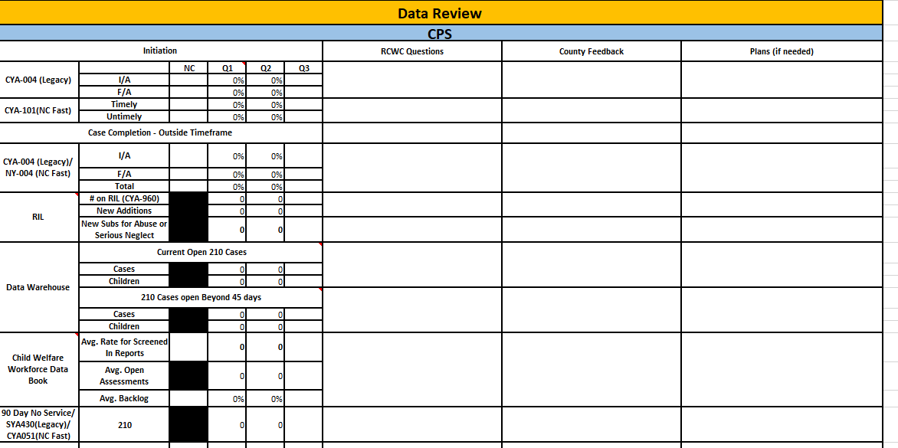
Child Welfare Data Review

Slide 6
CQI Assessment
Process Measures Data and Outcome Measure data on one document
Provides consistency across NC for data, law, rule and policy expectations that have the greatest impact on Children and Families or coincide with OSRI
Standard column, indicates expectations according to Federal Government or Law
Enhanced Technical Assistance or Corrective Action Column, indicates prior data/record review averages from statewide data
Counties with data below this column, NCDSS will provide enhanced technical assistance to support the agency in improving numbers to improve to the statewide average
Counties with data above this column, NCDSS will continue to provide technical assistance as needed to support the agency in working towards the standard percentage

Slide 7
What is still to come? CQI Assessment continued
Permanency Data |  | Standard |  | Enhanced TA/CAP |  | Review Date: |  | Last Program Evaluation |  | Review Date: |  | Review Date:
 |  | Expected % Achieved |  | Review % Lower than… |  | % Achieved |  | % Achieved |  | % Achieved |  | % Achieved
Percent of effective Social Worker FTE’s (Permanency Planning) |  | 95% |  | 87%
Percent of effective Social Worker FTE’s (Permanency Planning 18-21) |  | 95% |  | 95%
Percent of effective Social Worker FTE’s (Adoption) |  | 95% |  | 94%
Ongoing face to face contacts made per policy in Permanency Planning with (or diligent efforts documented): | Children | 95% |  | 85% | 25%
 | Mothers | 95% |  | 50% | 48%
 | Biological Fathers | 95% |  | 30% | 39%
 | Resource Parents | 95% |  | 80% | 25%
Contact was made with persons significant to the case, other than the placement providers, when indicated by the child and family’s needs |  | 95% |  | 69%
Case narratives contained appropriate information per policy |  | 95% |  | 78%
Case specific supervisory consultation components |  | 95% |  | 29%
FSA development and updates according to policy with: | Mothers | 95% |  | 66% | 54%
 | Fathers | 95% |  | 51% | 44%
FSA correlates to Family Strengths and Needs Assessment: | Mothers | 95% |  | 65%
 | Fathers | 95% |  | 59%
Family Reunification Assessment (DSS-5227), and the Family Assessment of Strengths and Needs (DSS-5229) completed thoroughly and accurately. |  | 95% |  | 42%
Family Time and Contact Plan developed | Initial within 14 days | 95% |  | 71%
 | Updated | 95% |  | 49%
Family time occurs frequently and includes a variety of methods |  | 95% |  | 67%
Documentation of family time includes behavioral observations |  | 95% |  | 72%
Contact between siblings occurs frequently |  | 95% |  | 66%
Siblings not placed together are reviewed to be placed together |  | 95% |  | 32%
Shared Parenting Meeting | Initial within 14 days | 95% |  | 29%
 | Ongoing | 95% |  | 25%

Slide 8
Questions?
Teresa.strom@dhhs.nc.gov
Jennifer.oshnock@dhhs.nc.gov
Peter.west@dhhs.nc.gov

