Slide 1
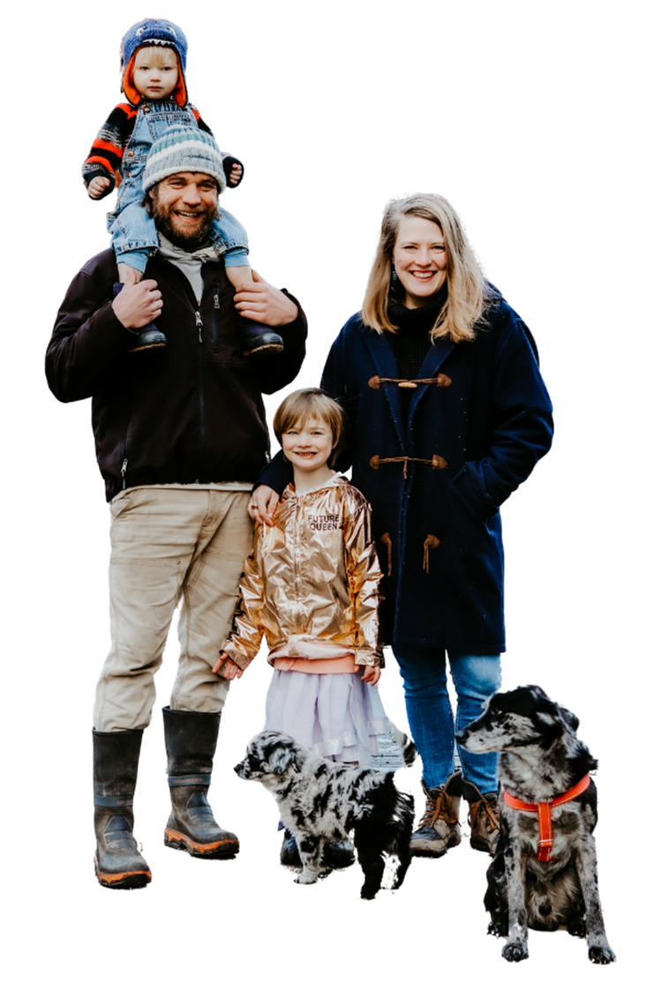
Fueling Changes for Children and Families
Marjorie Sims, Managing Director, Ascend
May 2022

Slide 2
Agenda
History & Overview
Key Learnings and Hallmarks
Continuums and Barriers

Slide 3
The Aspen Institute: Principles that Endure and Inspire
The Aspen Institute is an educational and policy studies organization with the mission of fostering values-based leadership and providing a nonpartisan venue for dialogue around critical issues.
The timeless values that inspired the creation of the Institute after
World War II continue to guide us today.

Slide 4
Ascend at The Aspen Institute: A New Way Forward for Children and Families
A catalyst and convener for systems, policy, and social impact leaders working to create a society where every family passes a legacy of prosperity and well-being from one generation to the next.
We co-create and elevate innovative two-generation (2Gen) approaches with families and partners to forge pathways to educational success and economic mobility for both children and the adults in their lives.
We invest in leadership to advance systems, policy, and narrative change.
We elevate and scale ideas and innovations that show early traction in communities.
We leverage the power of convening and foster radical collaboration.

Slide 5
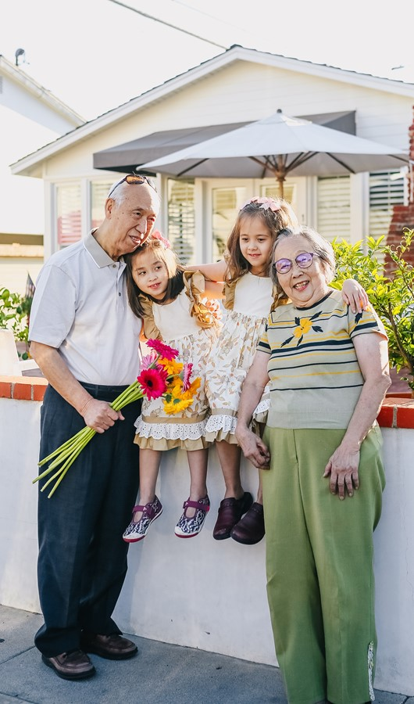
The Two-Generation (2Gen) Approach

Slide 6
The Two-Generation Approach is…
Two-generation (2Gen) approaches build family well-being by intentionally and simultaneously working with children and the adults in their lives – together.
6

Slide 7
2Gen 1.0 History
Inherent in indigenous communities
Late 1800s – Settlement Houses
1965 - Head Start
1970’s-1980’s - Family Resource Efforts
1988 – Term ‘Two-Generation’ Coined by the Foundation for Child Development
1996 – St. Pierre et. al evaluation

Slide 8
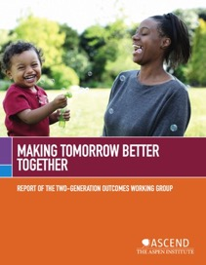
What Have We Learned from 2Gen 1.0?
Intentional service integration is critical
Quality matters
Intensity is important
Who is targeted matters
How you work with families matters

Slide 9
A college degree doubles a parent’s income. (Kominski, 2011)
Why a 2Gen Approach?
A $3,000 increase during early childhood yields a 17% increase in adult earnings. (Duncan & Magnuson, 2011)
Research shows that supporting children and their caregivers together has an outsize impact for generations.
Predictable, monthly unconditional cash aid given to low-income families may increase infant brain activity. (Troller-Renfree et al., 2022)
The brains of new parents undergo major changes. (Phu, Erhart, Kim, & Watamura, 2020)
Research demonstrates a 13% ROI in high quality early childhood education. (Heckman, 2016)
Parents with health insurance are more likely to seek care for their children. (Rosenbaum & Whittington, 2007)
9

Slide 10
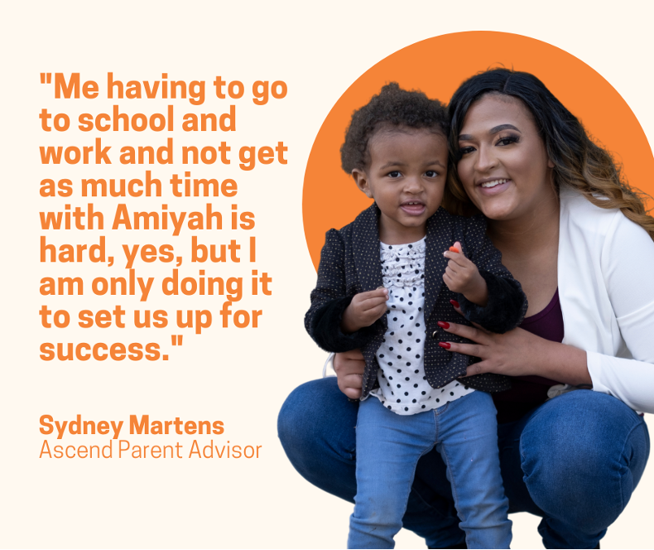
Principles of the 2Gen Approach
Measure and account for outcomes for both children and their parents (or the adults in their lives).
Engage and listen to the voices of families.
Ensure equity, particularly racial equity.
Foster innovation and evidence together.
Align and link systems and funding streams.
10

Slide 11
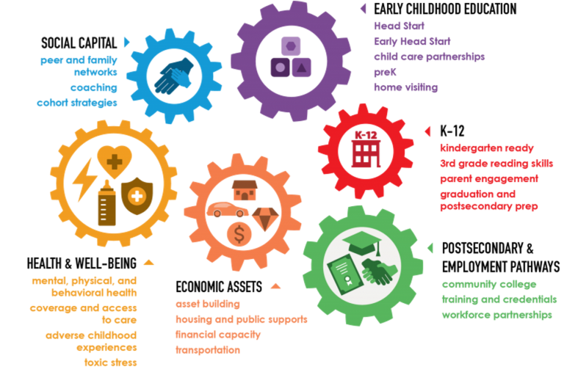
What We’re Going For: Family Well-being
Well-being is a multifaceted process and lifelong pursuit. Ultimately, 2Gen approaches recognize six key components to improve families’ financial stability, social capital, health care, and quality education.

Slide 12
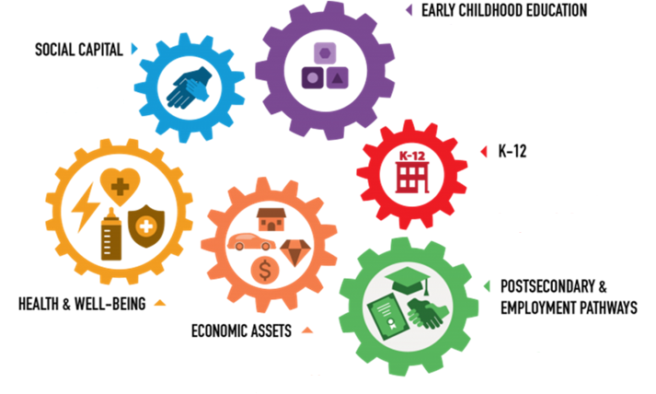
Theory of Change
For an increase in family economic security, educational success, and health and well-being from one generation to the next by 2025

Slide 13
Many Names – ONE Approach
2Gen approaches reflect and embrace the diverse shapes, sizes, and structures of families to ensure all family members can reach their full potential.
“Whole Family”
“Multi-Gen”
‘Ohana Nui
“Intergenerational”
“Two-Generation”
“Multigenerational”
“Family Economic Mobility”
“2Gen”
13

Slide 14
Hallmarks of 2Gen
A set of characteristics that puts the 2Gen principles into action and describe what a 2Gen approach, strategy, organization, or system looks like. In most 2Gen efforts, leaders are consciously and conscientiously choosing to do the following:
Center on families and their strength.
Integrate services.
Remove barriers.
Advance racial equity.
Lead from values and partner with leaders eager to push the levers of change.
Shift providers’ mindsets.
Partner.
Measure family outcome.

Slide 15
2Gen Organization Continuum
Approach
Strategy
Organization
A new mindset for designing programs and policies that serve children and parents simultaneously.
Aligning and/or coordinating services with other organizations to meet the needs of all family members.
Providing services to both children and adults simultaneously and tracking outcomes for both.
Cultural competency is a prerequisite

Slide 16
2Gen Community Continuum: Stages of 2Gen Implementation
2Gen Unaware: Fragmented programs and systems due to limited understanding of the 2Gen framework.
2Gen Awareness Raising: Stakeholders beginning to learn about 2Gen and engaging others to learn more.
2Gen Approach: Stakeholders aware of and support existing 2Gen organizations, and move on to “development” if there are any gaps.
2Gen Strategy: Cross-sector stakeholders working collaboratively to align and/or coordinate programs, policies, organizations and systems to reflect the 2Gen framework and ingrain it in their mission.
2Gen Pilot or Initiative: Cross-sector stakeholders working collaboratively to provide services to both children and adults simultaneously.
2Gen Integration: Both children and adults are being simultaneously served in multiple programs across multiple sectors.
2Gen Accountability: Sustained programs, policies and practices.

Slide 17
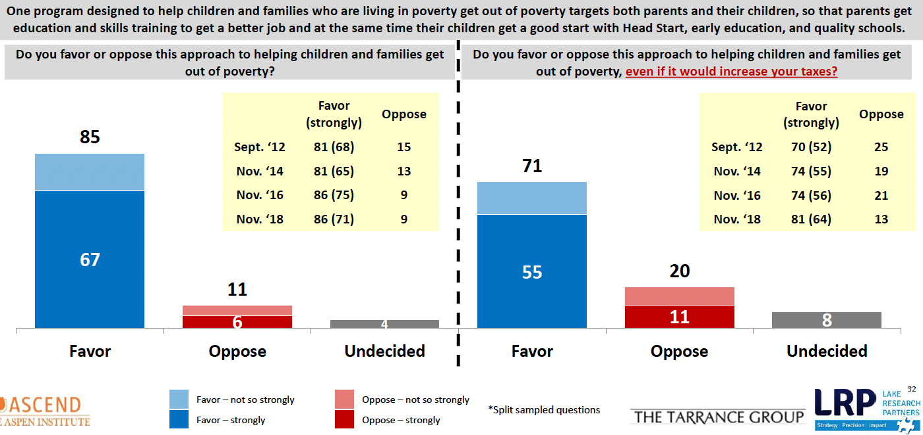
Voters are tax sensitive, but a majority still strongly favor the two-generation approach and public programs that helps parents get education and skills training while children get a good start and even if it increased their taxes.
2Gen Impact: Broad Awareness and Adoption of 2Gen Approach
17

Slide 18
Key Challenges and Barriers to 2Gen Implementation
Lack of clear collaboration partners and/or terms of agreement
Staff buy-in and capacity
Parent recruitment and retention
Knowledge of and access to blended funding streams
Policy barriers: lack of aligned resources and policies

Slide 19
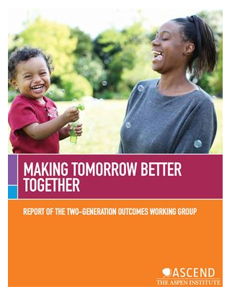
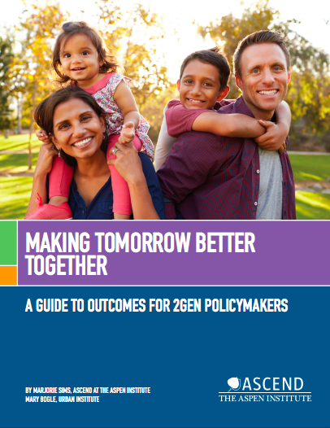
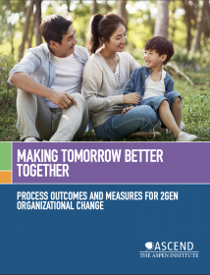
Outcomes Frameworks for 2Gen Approaches

Slide 20
Questions?
Visit: aspeninstitute.org
Follow: @AspenAscend
Contact: marjorie.sims@aspeninstitute.org
20

