Slide 1
NC Department of Health and Human Services
Benefits of the Regional Model for Child Welfare Services
Holly McNeill, Facilitator
August 4, 2022
Notes:
Will have 6 flip charts up with 3 houses (1 set on each side of the room): House of Worries/Questions; House of Hopes; House of Next Steps We will invite participants to add their input as they enter the room using post it notes, and check on these houses later in the presentation.
Good Morning! I am excited to be here with all of you and to discuss the future of Child Welfare in NC. We have a rather short time with you this morning, and are very anxious to answer your questions and hear your thoughts and feedback. Please see this as on opportunity to have a conversation and feel free to raise your hand during the presentation. We will let speakers finish their brief presentation before taking questions. If you are more comfortable, you can also write your questions on an index card and we will collect those and answer as many as we can.
Holly

Slide 2
Panelists
Tammy Shook, Interim Deputy Director for Child Welfare Operations
Holly McNeill, Statewide CQI Lead
Kathy Stone, Safety Section Chief
Heather McAllister, Family First Prevention Services Manager
Emi Wyble, Regional Abuse and Medical Specialist Manager
Notes:
Holly, I am joined by several colleagues who are going to share some exciting info. I am Holly McNeill, and I am the Statewide CQI Lead, Tammy Shook, the Dep Dir for CW Op is here, as is Kathy Stone, Safety Sec Chief, Heather McAllister, FFPS Manager, and Emi Wyble, RAMS Manager START with a scaling question On a scale from fist to 5 where fist is you know nothing about the regional model and 5 is I practically wrote the book on Regional Models, where would you scale yourself.

Slide 3
Goal
Provide information regarding the Regional Support Model and how it will support counties.
Prepare county child welfare agencies for the change.
Solicit feedback on the model and how NCDSS will provide support.
Notes:
Holly We have 90 minutes to share some information about the Regional Support Model and how will support Co. agencies, and hear from you about your thoughts on how NCDSS can provide support.

Slide 4
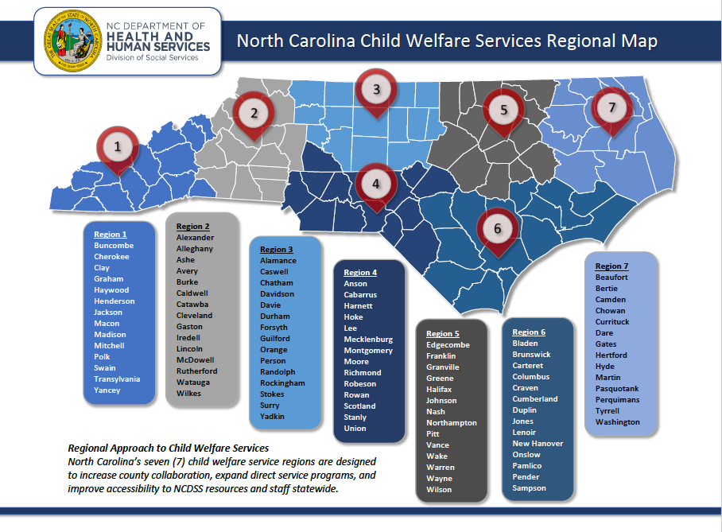
Notes:
Holly Just to remind everyone of what the regional map looks like. It has been organized to try and balance several elements (# of foster kids, # of counties, land area,

Slide 5
Rylan’s Law HB 630
Passed 6/15/2017
Requires regional offices to support and supervise counties
Outlines how NCDHHS will supervise county DSS agencies.
Notes:
Holly It’s important to remember what brought us to this place. In June of 2017 the GA passed Rylan’s Law and part of that legislation required the move to a regional model of support and supervision, as well as outlining how NCDHHS will supervise county agencies. This is a big transition for our state and we want to be thoughtful moving forward. Which brings us to where we are now, preparing to continue the transition.

Slide 6
Who will be supporting your county?
CQI, Safety, and Permanency Specialists
RAMS Consultant
FFPSA Regional Consultant
Family Support Prevention Services
Regional Trainers
These positions are either in place or in the process of being hired.
Notes:
Holly Each region will have a team of specialized staff to support them in the work you do each day. We want to take some time this morning to tell you a little about each position and invite you to ask questions and give us feedback on how we can best support counties moving forward. We want this to be conversation, so feel free to speak up, or write your question on an index card and someone will pick them up.

Slide 7
CQI Specialists
The CQI Specialist will:
Gather and assist in analyzing your data,
Provide record reviews
Discern and monitor trends
Coordinate with other state staff
Notes:
Holly CQI specialists will coordinate and record reviews for your region (that process is still under construction, thoughts?) They will also be pulling and analyzing data, and will, in partnership with other consultants discuss data with you to learn about the story behind the numbers. They will be looking for trends in data, both regionally and for individual counties. And of course will coordinate with other state staff.

Slide 8
Safety Specialist
The Safety Specialist will:
Provide policy and practice support
Provide TA in safety areas
Coordinate with other state staff
Notes:
Kathy

Slide 9
Permanency Specialist
The Permanency Specialist will:
Provide policy and practice support
Provide TA in permanency areas
Coordinate with other state staff
Notes:
Kathy

Slide 10
RAMS Consultant
The Regional Abuse and Medical Specialist Consultants have an overall goal of providing guidance to the child welfare workforce in the management of high-risk child welfare cases that overlap with medical issues.
The focus population is:
Children 3 years of age and under who present with unexplained/poorly explained injuries
Children of any age with medically complex issues
Children 3 years of age and under that have an STI
Children of any age with a concern for medical child abuse
SOURCE:
Notes:
Emi

Slide 11
FFPSA Regional Consultant
The FFPSA Regional Consultants will:
Educate counties about FFPSA funded services
Support the development of an infrastructure that ensures FFPSA services are available statewide
Provide technical assistance to counties on the FFPSA processes, policies, and services system
Coordinate across multiple child service agencies in the building of a comprehensive continuum of community-based services and supports
Notes:
Heather

Slide 12
Family Support Prevention Services
Goal: Provide a variety of prevention programs that families can access to meet their needs regardless of which county they live in NC.
Voluntary, evidence-based programs designed to prevent child abuse and neglect
Parent Education, Parent Support, Home Visiting, and Respite Programs
Strengthen Protective Factors and Resilience
Comprehensive prevention framework that aligns primary, secondary family strengthening programs with tertiary Family First prevention services
Potential delivery mechanism = Family Resource Centers
Notes:
Kathy 2 slides
NCDSS braids federal and state funding from Community Based Child Abuse Prevention (CBCAP), Promoting Safe and Stable Families (IVB-2), and NC Children’s Trust Fund.
Protective Factors: Parental Resilience, Social Connections, Knowledge of Parenting and Child Development, Concrete Support, Children’s Social and Emotional Development
NCDSS is facilitating a Prevention Planning Workgroup to develop a comprehensive Prevention Plan that aligns NCDSS Family Support Programming with FFPSA in a regional model.
NCDSS is exploring the possibility of Family Resource Centers to provide services in a one-stop, non-stigmatizing manner.
To start alignment:
NCDSS’s selection criteria for the current 2022-2024 family support and respite grant cycle required regional distribution. There is a least one program located in each region. At this point, grantees are not serving every county in each region, however.
NCDSS expanded the list of allowable evidence-based programs that family support agencies could provide to include 2 FFPSA models – Parents as Teachers and Triple P, Level 4. This will build capacity and allow agencies to provide primary, secondary, and tertiary services.
NCDSS partnered with PCANC to develop a Family Resource Center Network in NC to build their capacity and provide implementation support and professional development opportunities.

Slide 13
Family Support Prevention Services
First Steps:
Regional distribution of current programs
Include FFPSA program models: Parents as Teachers and Triple P, Level 4
Develop Family Resource Center Network
Notes:
Kathy

Slide 14
Coming soon… Regional Trainers
Each region will have 2 trainers
All of the required trainings will be trained by these trainers.
Benefits
Your staff will know what to expect.
Trainers will get to know your staff.
Trainings will be offered within your region.
Notes:
Holly Eventually, trainers, like the other positions we have discussed, will be assigned to regions. These regional trainers will provide the required trainings within the region, to lessen travel. Your staff will get to know these trainers and visa versa. Other trainings will continue to be offered throughout the state and virtual trainings will continue to be used where possible.
Would you like to host? At least 2 in each region, in 4 regions we already have the trng center. Bringing back pre-serv and Assess in Sept, , next calendar 12 assess, 1 virtual and 1 in person each month

Slide 15
Other Staff Who Will Support the Regional Model
Intensive TA Consultant and Intensive Trainer Both of these positions will work with counties in need of more intensive support without pulling regional staff from their other counties.
Statewide CQI Lead
Licensing and Regulatory team
OSRI
Staff Development team
NC KIDS and LINKS
Notes:
Holly The Intensive TA Consultant and Trainer will be statewide positions who will work with counties who need more intensive support for a time. The rest of these positions will continue to support county agencies on a statewide level

Slide 16
How Will Your Needs Be Met?
Monthly onsite consults
Specialized staff will be more equipped to answer your questions in each area
These will be completed by a combination of the Safety, Permanence and CQI specialists, depending on the current needs of each county
Regional and statewide staff will collaborate and communicate to ensure that counties receive holistic support
As with any change, it will be hard work, and we believe it will be worth it!
Notes:
Holly Monthly consults will continue, what those will look like will very from county to county, depending on needs. You will NOT need to meet with 3 or 4 different people monthly. Regional staff will collaborate to ensure that counties needs are met in each area. Our goal is for regional staff to have one area to concentrate on, allowing them to be better able to answer your questions quickly. How would you see this as working?

Slide 17
How Will Your Needs Be Met?
Regional Meetings
Held quarterly at a central location in each region
You will need to attend in your region
Meetings will include a general session and breakouts for different areas so that you get the most bang for your buck!
Notes:
Holly? We will be working with the CQI Design team to plan and shape these meetings. Agendas will be sent out a head of time. We will look at regional data together and discuss what the data means, and what the possible root causes are, and we will think about how we can improve the numbers on a regional level, which will mean each county will need to do their part.

Slide 18
Check in on the 3 Houses
Have we answered some of the questions you had?
Have we addressed some of the concerns you had?
What questions remain?
What worries remain?
What are you excited about?
Do us a favor….share your excitement!
Notes:
Holly Let’s check in on the Fist to 5 question again. Have any of you changed your number? Have we been able to answer some of the questions you had? If you have heard anything that you are excited about, share that excitement with someone else today! If you have more questions, find one of us and talk to us, most of us will be here for the rest of the Institute. We will be touching base with some of the questions we didn’t get today at our first regional meetings, so stay tuned.

Slide 19
What have you done; or what will you do to make your agency most ready for this shift?
This Photo by Unknown Author is licensed under CC BY-SA
Notes:
Somebody share something you will do to prepare yourself, your staff or your agency for this shift.

Slide 20
When You Need Us!
Tammy Shook, Tammy.shook@dhhs.nc.gov
Peter West, Peter.west@dhhs.nc.gov
Heather McAllister, Heather.mcallister@dhhs.nc.gov
Holly McNeill, Holly.mcneill@dhhs.nc.gov
Kathy Stone, Kathy.stone@dhhs.nc.gov
Emi Wyble, Emi.Wyble@dhhs.nc.gov
Carla McNeill, Carla.mcneill@dhhs.nc.gov

