Slide 1
NC Department of Health and Human Services
Children’s Services Committee
DSS Child Welfare Services Team
December 5, 2018

Slide 2
Child Welfare Updates
Family First Prevention Services Act
Modified Manual
Child & Family Services Review (CFSR)
Adoption Promotion
Wendy’s Wonderful Kids
Human Trafficking Policy
Water Hazard Safety Policy

Slide 3
Family First Prevention Services Act

Slide 4
Family First Prevention Services Act Contact Information
https://www.ncdhhs.gov/divisions/social-services/family-first-prevention-services-act-information
FFPSA@dhhs.nc.gov

Slide 5
Modified Manual

Slide 6
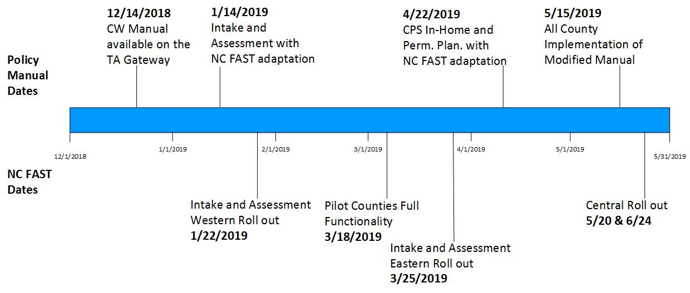
Modified Manual Timeline vs. NC FAST

Slide 7
Modified Manual “Crosswalk”
A key tool for all staff
Will be included in upcoming DCDL and will be posted on the TA Gateway
Organized by functional area
Includes cumulative list of all changes
Includes justification for all changes

Slide 8
Modified Manual Contact
Terri Reichert, MSW
Policy Consultant
Terri.Reichert@dhhs.nc.gov
(919) 527-7295

Slide 9
Child and Family Services Review (CFSR) and Onsite Review Instrument (OSRI)

Slide 10
CFRS/OSRI
Where We Are
Meeting many of our PIP goals
Abundance of activities aiding in improvement
OSRI is one measurement tool for quality assurance
Where We’re Going
Keep Improving/CQI
Long-term vision is to continue to improve to 95%
How to Get There - TOGETHER!

Slide 11
New Resources Coming!
State Results At-A-Glance

Slide 12
New Resources Coming!
Case Review Summary

Slide 13
Safety Outcome 1
Children are, first and foremost, protected from abuse and neglect. (One Item)
Item 1: Timeliness of initiation
PIP IMPROVEMENT GOAL: 76.7%
To be rated a strength… Reports must be initiated within timeframes. All children seen face to face at initiation. Includes cross-jurisdiction assist requests.
Be sure to document why if unable to initiate on time…

Slide 14
Safety Outcome 2
Children are safely maintained in their homes whenever possible and appropriate. (Two Items)
Item 2: Assessing for and providing services to prevent entry or re-entry into foster care.
PIP IMPROVEMENT GOAL: 66.4%
Item 3: Assessing and managing risk and safety throughout the life of the case.
PIP IMPROVEMENT GOAL: 62.2%

Slide 15
Safety Outcome 2 (continued)
Children are safely maintained in their homes whenever possible and appropriate. (Two Items)
To be rated a strength… Agency efforts need to: Identify and provide appropriate services that address immediate safety needs and prevent foster care Show that safety and risk are being assessed and monitored throughout the life of the case, in all programs. Identify and provide appropriate services that are intended to reduce risk of future harm

Slide 16
Safety Outcome 2 (continued)
Children are safely maintained in their homes whenever possible and appropriate. (Two Items)
To be rated a strength… Safety plans are Appropriate for the situation and child Current, and Family engagement in safety-related services monitored.

Slide 17
Safety Outcome 2 (continued)
Children are safely maintained in their homes whenever possible and appropriate. (Two Items)
To be rated a strength… All assessments and reassessments should be timely and throughout the life of the case. The rule of thumb is to reassess at critical points in the life of the case.

Slide 18
Permanency Outcome 1
Children have permanency and stability in their living situations. (Three Items)
Item 4: Stability of Placement
PIP IMPROVEMENT GOAL: 70.6%
Item 5: Permanency goal for the child
PIP IMPROVEMENT GOAL: 54.7%
Item 6: Achievement of Permanency
PIP IMPROVEMENT GOAL: 48.3%

Slide 19
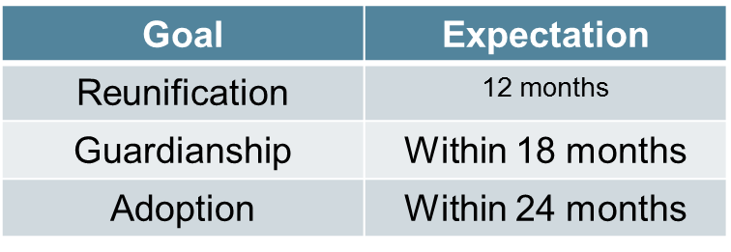
Permanency Outcome 1 (continued)
Children have permanency and stability in their living situations. (Three Items)
To be rated as a strength: The child’s placement AND permanency goal are appropriate. Any placement change reflects agency efforts to achieve case plan goals. The permanency goal was established timely: when the child entered foster care or if the permanency goal is changed. The permanency goal was achieved timely.

Slide 20
Permanency Outcome 2
No PIP Goal attached
Continuity of family relationships and connections is preserved for children. (Five Items)
ITEM 7: Placement with Siblings
ITEM 8: Visiting with Parents & Siblings in Foster Care
ITEM 9: Preserving Connections
ITEM 10: Relative Placement
ITEM 11: Relationship of Child in Care with Parents

Slide 21
Permanency Outcome 2
No PIP Goal attached
Continuity of family relationships and connections is preserved for children. (Five Items)
To be rated as a strength: Siblings are placed together (including large groups) Efforts made to maximize frequent and consistent visitation between children in care and their parents and siblings Support a child’s important connections Ongoing efforts to contact relatives and support relative placement Actively involving the parents in the case Coaching Encouraging Using shared parenting with foster parent

Slide 22
Well-Being Outcome 1
Families have enhanced capacity to provide for their children’s needs. (Four Items)
ITEM 12: Assessment of Needs and Services for Child, Parents, and Foster parents
PIP IMPROVEMENT GOAL: 48.5%
ITEM 13: Involvement of Child & Parents in Case Planning
PIP IMPROVEMENT GOAL: 52.2%
ITEM 14: Caseworker Visits with Children
PIP IMPROVEMENT GOAL: 65.8%
ITEM 15: Caseworker visits with Parents
PIP IMPROVEMENT GOAL: 46.7%

Slide 23
Well-Being Outcome 1 (continued)
Families have enhanced capacity to provide for their children’s needs. (Four Items)
ITEM 12: Assessment of Needs and Services for Child, Parents, and Foster parents
Special Note for Item 12: Examines agency efforts to assess for needs and provide services to meet those needs for: Children Parents Foster Parents Typically, agencies do very well at assessing needs and services for the child and for the foster parents. Improvement is needed for parent assessments, particularly for absent and incarcerated parents.
Notes:
Explain that item 12 is broken into three components, and point out that it is the parent component that is often the lowest score.

Slide 24
Well-Being Outcome 1 (continued)
Families have enhanced capacity to provide for their children’s needs. (Four Items)
To be rated as a strength: Needs are assessed at regular intervals throughout the life of the case. Appropriate services to address identified needs are provided, monitored, and updated at regular intervals throughout the life of the case. Case Plans indicate child and family engagement and understanding. Social worker visits are frequent and reflect the safety and risk aspects of the case. The quality of the interaction between social workers, children and families includes: home visits, focus on goals and case plan activities, and individual time with age and developmentally appropriate children.
Notes:
Very important to understand that assessment of needs and provision of services; assessment of success of case plan, and contact with children and families is essential for success of achieving and or maintaining permanency.
Please WRITE about efforts in case documentation. Interactions with children and families should be purposeful, and designed for goal achievement or support to actions necessary to protect children.

Slide 25
Well-Being Outcome 2
No PIP Goal attached
Children are, first and foremost, protected from abuse and neglect. (One Item)
Item 16: The agency assesses and addresses the education needs of the child.
To be rated as a strength: The agency: made concerted efforts to assess children’s educational needs throughout the life of the case. ensured that identified educational needs were appropriately addressed in case activities. Educational assessments, including evaluations are included in the case file.

Slide 26
Well-Being Outcome 3
No PIP Goal attached
Children receive adequate services to meet their physical and mental health needs (Two items)
Item 17: Physical Health of the Child (including dental)
Item 18: Mental/Behavioral Health of the Child
To be rated a strength: Throughout the life of the case: Assess for physical health and dental health needs Assess for mental health and behavioral health needs For foster care cases, any medications the child is taking are monitored by a physician Included in the record: Medical and dental health records Mental and behavioral health records

Slide 27
Resources
Children’s Bureau Website http://www.act.hhs.gov/programs/cb/monitoring/child-family-services-reviews
Child Protective Services: A Guide for Caseworkers 2018; Diane DePanfilis, PhD., MSW https://www.childwelfare.gov/pubs/usermanuals
On-demand, self-paced, online course: North Carolina’s OSRI/Case Review Process: What to expect https://www.ncswlearn.org/

Slide 28
OSRI Contact
Cynthia O’Briant, MSW
Program Manager CFSR/OSRI QA Team
cynthia.obriant@dhhs.nc.gov
(919) 527-6295

Slide 29
Adoption Promotion Program

Slide 30
Adoption Promotion Program Goals
Incentivize
Incentivize the adoption of more children
Establish
Establish clear fee-for-service payment rates for child placing agencies
Develop
Develop separate funding pools for private agencies and county child welfare agencies
Create
Create more predictable funding across years
Clarity
Clarity in roles for child placing agencies and child welfare agencies

Slide 31
Adoption Promotion Program Structure
County Child Welfare Agency
Federal Baseline
Year-End Distribution
Private Child Placing Agency
Defined Service Areas & Rates
Fee for Service
Partnership
is
Power

Slide 32
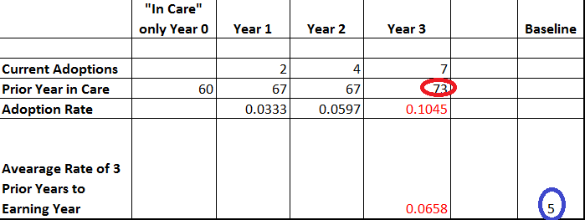
Federal Baseline
Federal Baseline
Data is used from the previous 4 fiscal years.
Determine a county adoption rate by dividing the number of completed adoptions in one year by the number of youth in care the year prior.
Determine which adoption rate is lowest – the Year 3 adoption rate or the average of the past 3 years. Multiply the lowest adoption rate by the number of youth in care in Year 3 to determine a county baseline for the current year.

Slide 33
YEAR-END DISTRIBUTION
County child welfare agencies will receive a one-time, year-end funding allocation for eligible adoptions.
The allocation is a proportional share of the total statewide funding ($3.2M) available to all counties based on the sum of two factors:
The total number of special needs adoptions completed, regardless of age, that exceed federal adoption baseline targets for each county.
The total number of adoptions completed for children 13 years and older and/or sibling groups of 3+ placed together for adoption, that fall under the federal baseline target.
FORMULA
(# eligible county adoptions / # eligible statewide adoptions ) X available statewide funding

Slide 34
Role Clarity – Service Areas
Adoptive Family Readiness
Family Post Placement Support
Child Post Placement Support
Legal Services

Slide 35
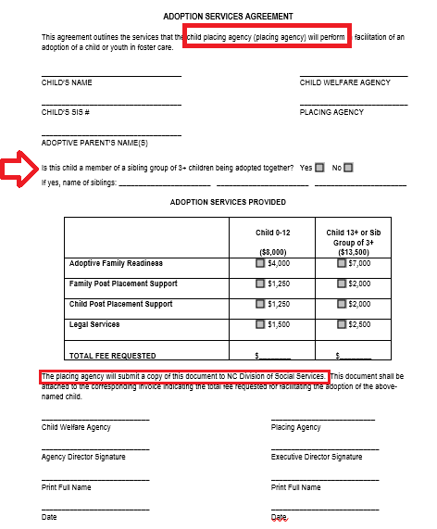
Revised Adoption Services Agreement
Revised Adoption Services Agreement
The ASA only reflects services the private agency performs for the child welfare agency.
The funding amounts listed only pertain to private child placing agencies.
Only private child placing agencies submit the ASA.
Child welfare agencies must sign the form to verify the service was provided.
Pending adoptions not finalized by December 31st must be transitioned to the revised ASA to reflect the new service areas. Agencies should work together to facilitate this as quickly as possible.
Any new cases that will not finalize prior to December 31st should begin with the Revised ASA.

Slide 36
PAYMENT PROCEDURES

Slide 37
Fiscal Year Timeframes
SFY 2018-2019 funds must be distributed to county agencies prior to June 30, 2019. The following adjustments are in place to assure timeframes are met:
For SFY 2018-2019, counties will submit adoptions completed between July 1, 2018 – May 31, 2019.
Beginning in SFY 2019-2020, county agencies will submit adoptions for June 1st – May 31st.
Final submissions must be made no later than June 3rd to allow ample time for processing.

Slide 38
Steps For SFY 18-19 Submissions
1. Submit the DSS-5320 on required due dates:
December 10th (July 1 – Nov 30 adoptions)
March 10th (Dec 1 – Feb 28 adoptions)
No later than June 3rd (Mar 1 – May 31 adoptions)
2. DSS-5320 must be submitted via email to Kim Best at kimberly.best@dhhs.nc.gov
3. DSS-5320 must be password protected.
4. 5094s must be closed using the code for Adoption and 5095s opened for adoption assistance benefits.

Slide 39
Moving Forward
Adoption Promotion Program Criteria and Guidelines will be incorporated into the Child Welfare Services policy manual.
A webinar will be conducted on December 10th to provide additional information on the new program structure. It will be recorded and posted here: https://www2.ncdhhs.gov/dss/training/childwelfare.htm
The Department of Health and Human Services will continue to evaluate the APP to assess for further adjustments.

Slide 40
Adoption Promotion Program Contact
Kim Best
Permanency Coordinator
Kimberly.Best@dhhs.nc.gov
919-527-6354

Slide 41
Wendy’s Wonderful Kids Program

Slide 42
Wendy’s Wonderful Kid Program Contact
Rebecca Starnes, MS
Vice President, Programs and Quality Improvement
Children’s Home Society
rstarnes@chsnc.org
336-553-9705

Slide 43
Human Trafficking Policy

Slide 44
Human Trafficking: State Law Changes
Session Law 2018-68 (House Bill 776)
Session Law 2018-75 (Senate Bill 162)
Human Trafficking = Abuse and Neglect, regardless of the relationship between the perpetrator and child
Notes:
State Law Changes
This year, the North Carolina General Assembly passed human trafficking legislation that amended our state statutes relevant to child welfare. Both HB 776 and SB 162 amended the definitions of Abused Juvenile and Neglected Juvenile under Chapter 7B.
Together, these statutory changes have a big impact on how we screen reports of child trafficking during child welfare intake. Now, any child who is found to be a minor victim of human trafficking, regardless of the relationship to the perpetrator, is considered an abused and neglected juvenile. This means child welfare agencies can accept reports of human trafficking whether or not the parent, guardian, custodian, or caretaker was involved in the trafficking.
This reflects a significant change in policy and practice in regards to how we establish jurisdiction in these cases and our authority to intervene. However, it does not change our definition of caretaker.
Let’s first remind ourselves what we mean by human trafficking…

Slide 45
Resources
Dear County Director Letter, Change Notice, Policy, and Resource List: https://www2.ncdhhs.gov/dss/dcdl/2018.htm
CWS-40-2018, CWS-CN-05-2018, Human Trafficking Policy, Service Provider and Other Referrals in Human Trafficking Cases by County
Link to Webinar: https://www2.ncdhhs.gov/dss/training/childwelfare.htm

Slide 46
Key Points from the New Policy
The definitions of abused and neglected juvenile under G.S. 7B-101 have changed
The definition of caretaker has not changed
There does not have to be coercion or deception for a child to be considered a victim of sex trafficking
Notes:
Key Take-Aways from the New Policy
The definitions of abused and neglected juvenile have changed.
The definition of caretaker has not changed.
Someone under 18 cannot, by law, consent to their participation in sex trafficking. A 16 year old is NOT a prostitute, as they cannot consent to their participation – they are a victim of human trafficking.

Slide 47
Human Trafficking Policy Changes
CPS Intake
Engaging the Reporter
Authority to Intervene
Maltreatment Screening Tool
Screening Decisions
Reporter Notification
Practice Guidance
CPS Assessments
Conducting the Assessment
Making the Case Decision
Notes:
CPS Intake
Engaging the Reporter: When a reporter or the intake worker suspects human trafficking, the intake worker must complete the Human Trafficking portion of the CPS Structured Intake Report Form (DSS-1402). When the perpetrator is NOT a parent, guardian, custodian, or caretaker, the intake worker must obtain information about the parent’s protective capacity, willingness to take protective action, and role in the trafficking.
Authority to Intervene: Reports that do not involve the maltreatment of a child by a parent, guardian, custodian, or caretaker must be screened out, except for those alleging human trafficking. A child who is a victim of human trafficking is an abused and neglected child, regardless of their relationship with the perpetrator. Reports that meet the statutory definition of human trafficking must be screened in and accepted for assessment, even when the alleged perpetrator is not a parent or caretaker or is unknown.
Maltreatment Screening Tool: The maltreatment screening tool for human trafficking has been modified to prompt the intake worker to consider the allegations in terms of the TYPEs of trafficking which are defined in North Carolina Criminal Statutes as “involuntary servitude” and “sexual servitude”.
Screening Decisions: Again, if the allegations meet the statutory criteria for human trafficking, the referral must be accepted as abuse and neglect, regardless of the relationship between the perpetrator and the child. Response priorities have not changed, so the same timeframes apply.
Reporter Notification: The reporter notification must contain information and resources about human trafficking if the report is screened out.
Practice Guidance includes, but is not limited to, information intake workers should gather from the reporter when the child has moved from another country to the United States without a family member or is traveling with an adult to whom they are not related or with whom the relationship is unclear.
CPS Assessments:
Conducting the Assessment: Current policies and requirements for completing a thorough CPS Assessment are still in place. The North Carolina Safety Assessment and assessment tools are only completed with parents, guardians, custodians, or caretakers. These tools must not be completed with perpetrators who are not parents, guardians, custodians, or caretakers. Additional protocol and guidance is also provided on assessing cases of human trafficking, such as the role the parent may have played in the trafficking.
Making the Case Decision: Because a child victim of trafficking is by law an abused or neglected child regardless of perpetrator relationship, an agency’s decision to substantiate maltreatment in these cases is based only on the child’s status or experience. Additional protocol and guidance is also provided relative to making the case decision, such as the parent’s responsibility or role played, and when the agency must make a finding of abuse and neglect and/or sexual abuse.

Slide 48
Human Trafficking Policy Changes
Cross-Function Topic
Identifying a Victim of Human Trafficking
Notifications and Verifications
Safety Considerations
Resources
Role of Parent, Guardian, Custodian, or Caretaker
Notes:
Cross-Function Topic
Identifying a Victim of Human Trafficking: The cross-function topic provides some guidance regarding the risk factors and indicators associated with human trafficking.
Notifications and Verifications: Once the child is identified as a trafficking victim – either through a report or during the course of a CPS Assessment, In-Home Services, or Permanency Planning services – within 24 hours the child welfare agency must make certain notifications and verifications including checking with the National Center for Missing and Exploited Children, North Carolina Center for Missing Persons, and the appropriate local law enforcement agency to see if the child or youth has been reported missing, and notify the U.S. Department of Health and Human Services, Office on Trafficking in Persons to facilitate the provision of interim assistance if the child is a foreign national.
Safety Considerations: The child welfare worker must consider immediate safety issues and make decisions on behalf of the child in the context of the unique circumstances created by the trafficking. Child welfare workers must also provide resources to families which also can help the worker navigate considerations about placement, healthcare, visibility in the community, visitation with family members and releasing information.
Resources: If there is an open CPS Assessment, In-Home Services, or Permanency Planning case where trafficking is suspected or confirmed, a county child welfare agency must provide appropriate information and resources to the family.
Role of Parent, Guardian, Custodian, or Caretaker: In cases where the perpetrator of the human trafficking is not the parent, guardian, custodian, or caretaker, the County child welfare worker must assess and address the parent’s ability/willingness to keep the child safe.

Slide 49
Human Trafficking Policy Contact
Erin Conner, MSW
LINKS Coordinator
Erin.Conner@dhhs.nc.gov
919-527-6351

Slide 50
Water Hazard Safety Policy
Notes:
The policy change was the result of a reevaluation of the application of Administrative Rule 10A NCAC 70E .1112 EXTERIOR SETTING AND SAFETY regarding Foster Home licensing and water hazards around the home.
The policy was revised to allow Supervising Agencies more discretion in the evaluation of the exterior hazards around the home and the ability of the foster family to provide a safe environment for children placed in the home where a water hazard exists.

Slide 51
Water Hazard Safety Assessments for Foster Home Licensing
Change Notice issued on October 1, 2018
The revised policy became effective November 1, 2018
New Forms:
Water Hazard Safety Assessment Form (DSS-5018)
Individual Water Hazard Safety Plan (DSS-5018a)

Slide 52
Key Points from the New Policy
A fence around the entire perimeter of the foster home where a water hazard exists on or near the property is no longer required.
Potential water hazards that are not on or directly connected to the property are now to be assessed using the Water Hazard Safety Assessment Form.
Requirement for a foster family who installs a temporary or seasonal swimming pool that will remain in place for more than 24 hours, to either enclose the pool with a fence at least 48” high, or limit access to the pool by a removable ladder or a ladder that locks in place.

Slide 53
Key Points from the New Policy (continued)
Completion of the Water Hazard Safety Assessment form (DSS-5018) by the Supervising Agency Licensing Worker during every initial licensure process and at every license renewal.
Completion of the Individual Water Hazard Safety Plan (DSS-5018a) by the foster parent(s) and reviewed with the Social Worker at the initial visit, for every child placed in a home where a water hazard exists.

Slide 54
Deeper Dive on Policy
As part of the initial licensure process, and every relicensing process thereafter, the supervising agency must complete the Water Hazard Safety Assessment form (DSS-5018) with every family. Photos of the property and the water hazard are now required.
The Supervising Agency licensing worker is responsible for assessing hazards in and around the foster home. The licensing worker is responsible for making this assessment; this responsibility may not be delegated.

Slide 55
Deeper Dive on Policy (continued)
In-ground swimming pools on the property of the foster home must be enclosed by a fence at least 48 inches high with a locked gate.
Access to water in above ground swimming pools will be prevented by locking and securing the ladder in place or storing the ladder in a place inaccessible to the children.

Slide 56
Deeper Dive on Policy (continued)
If a foster family installs a temporary or seasonal swimming pool that will remain in place for more than 24 hours it must either be enclosed by a fence at least 48” high, or access must be prevented by a removable ladder or a ladder that locks in place.

Slide 57
Deeper Dive on Policy (continued)
A foster child must be protected from access to potential water hazards such as ponds, beaches, rivers, lakes, streams, etc. that are on the property, or directly connected to the foster home and can be seen from the foster home at any time of year. The potential water hazard must be enclosed by a fence at least 48 inches high with a locked gate, or by a fence at least 48 inches high with a locked gate around the yard while providing play space for children.

Slide 58
Deeper Dive on Policy (continued)
If the potential water hazard is not directly connected to the property, using the Water Hazard Safety Assessment form, the licensing worker must carefully assess the risk to foster children based on the distance from the foster home to the water hazard, and the applicants’ experience in supervising children who may have access to the water hazard.

Slide 59
Water Safety Hazard Policy Contact
Black Mountain
Regulatory and Licensing
828-232-3160

